Slide 1
Storm surges in the Western South Atlantic
Ricardo de Camargo
University of Sao Paulo, Brazil

Slide 2
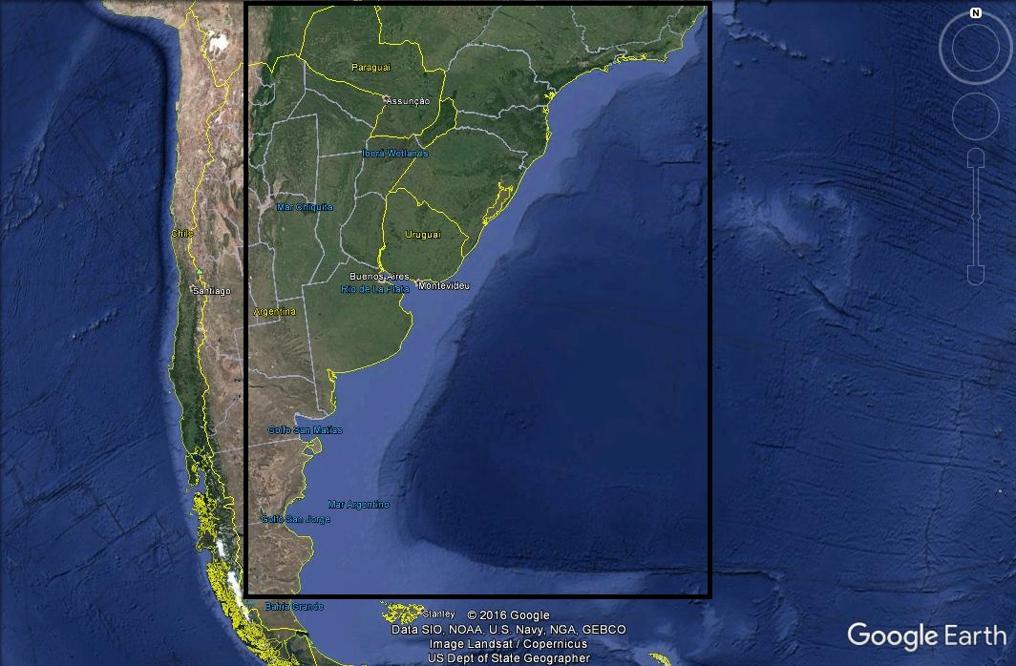
WESTERN SOUTH ATLANTIC
50ºS - 20ºS ; 070ºW - 040ºW
distinct astronomical tidal amplitudes
La Plata River
different width of continental shelf
cyclogenetic region
Brazil-Malvinas Confluence

Slide 3
NUMERICAL MODEL
Prof. George L. Mellor (turbulent closure and column model) and Dr. Allan F. Blumberg (2D modeling and horizontal structure of the oceanic flow) developed the first public domain ocean model freelly available to internacional scientific community
Princeton Ocean Model (BLUMBERG and MELLOR, 1983, 1987)
Some customization
tidal potential generator
boundary conditions for tidal elevations and vertically integrated currents
spatial filtering during integration
Newtonian relaxation to 3D temperature and salinity fields

Slide 4
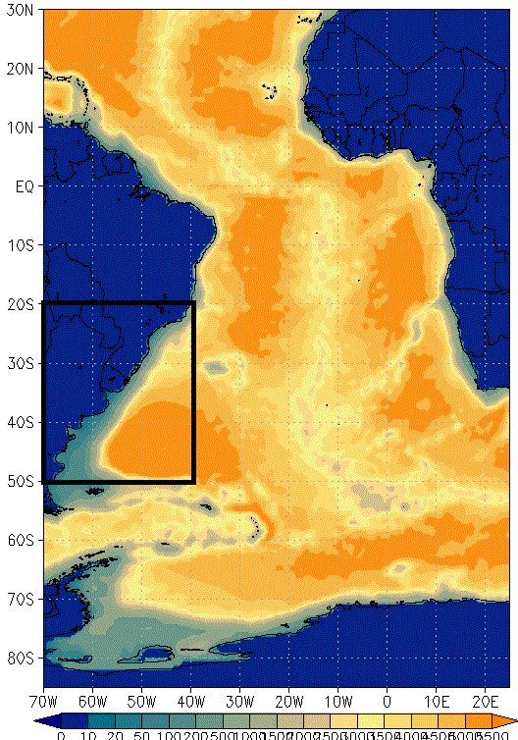
MODEL DOMAIN
Tropical and South Atlantic:
85ºS-30ºN e 070ºW-025ºE
0.5 x 0.5 degree in lat/lon
36 sigma levels
Bathymetry: ETOPO1
Simulated period:
01Jan1948-31Dec2010
Atmospheric forcing:
NCEP Reanalysis I 6/6hr
Initial, boundary conditions and Newtonian relaxation:
SODA2.2.4 monthly values

Slide 5
MODEL DOMAIN
Tides at open boundaries:
TPXO7.1
River discharge:
Orinoco (34000 m³/s)
Amazonas (175000 m³/s)
La Plata (15000 m³/s)
Congo (4000 m³/s)
Niger (6000 m³/s)
Outputs:
1/1h surface fields
24/24h 3D fields
Monthly averages 3D fields
Highlight: study region

Slide 6
STRATEGY FOR NUMERICAL EXPERIMENTS
Four simulations to combine different forcing:
Winds and Salt/Heat Fluxes (always considered)
Tides (on and off)
Sea Level Pressure (on and off)
Experiment 1: wind, fluxes, tides, slp
Experiment 2: wind, fluxes, tides
Experiment 3: wind, fluxes, slp
Experiment 4: wind, fluxes

Slide 7
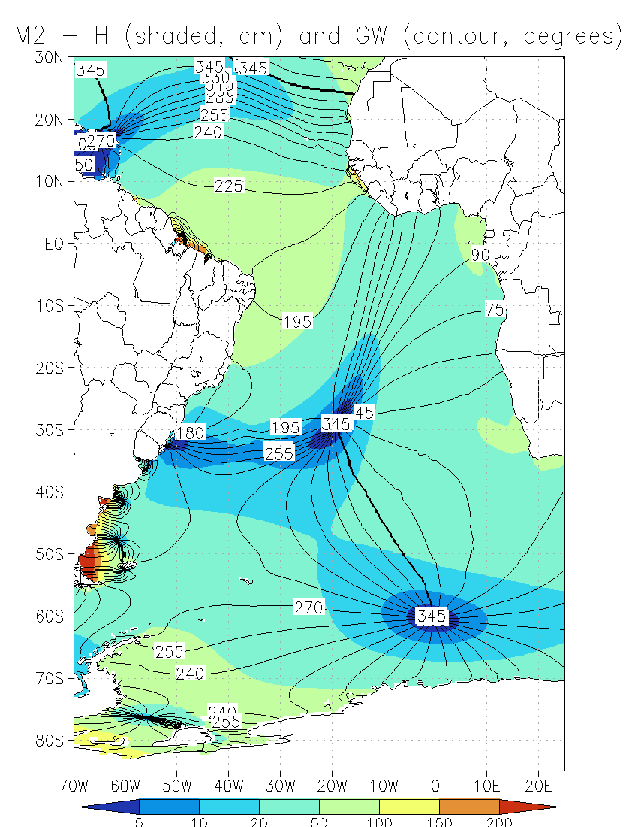
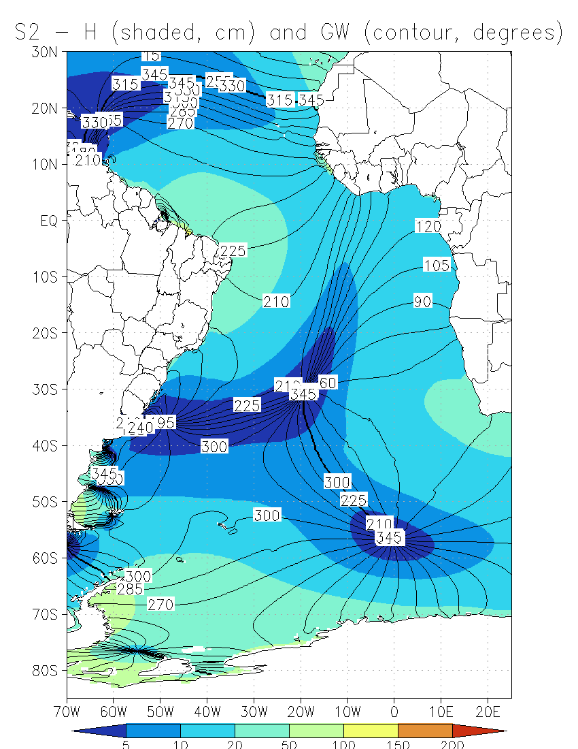
VALIDATION – Semi-diurnal constituents – Experiment 2
TPXO – M2
TPXO – S2

Slide 8
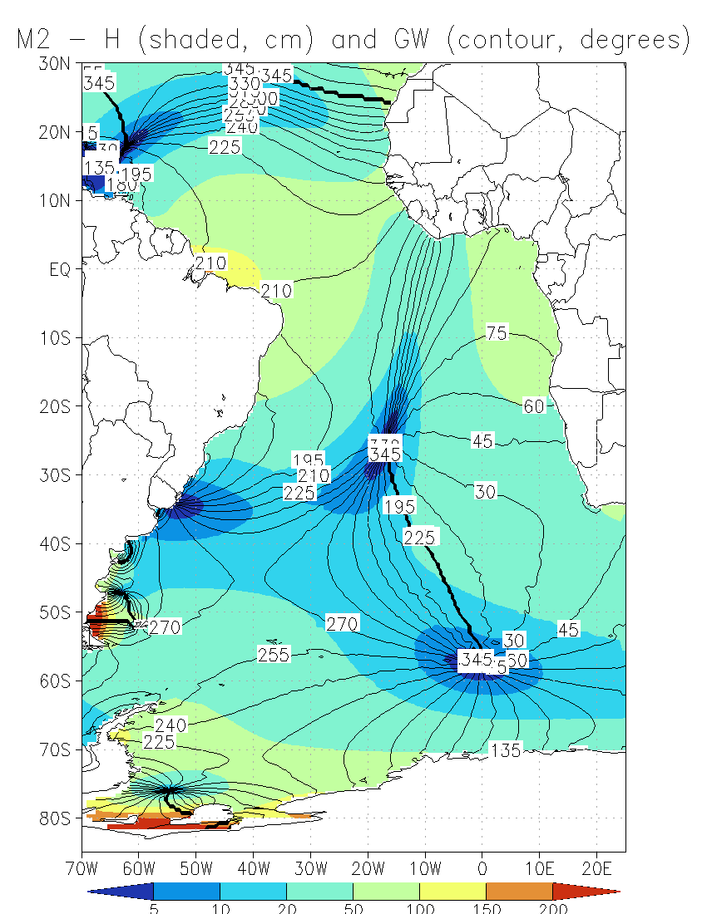
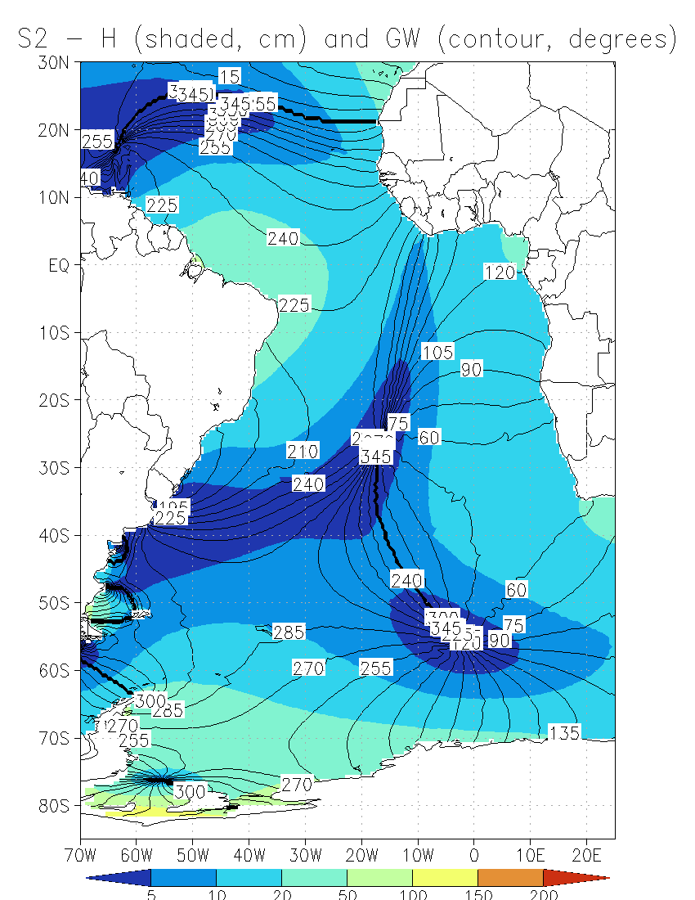
VALIDATION – Semi-diurnal constituents – Experiment 2
POM – M2
POM – S2

Slide 9
VALIDATION – Diurnal constituents – Experiment 2
TPXO
O1
TPXO
K1
POM
O1
POM
K1

Slide 10
VALIDATION – Semidiurnal constituents – Experiment 2
TPXO
M2
TPXO
S2
POM
M2
POM
S2

Slide 11
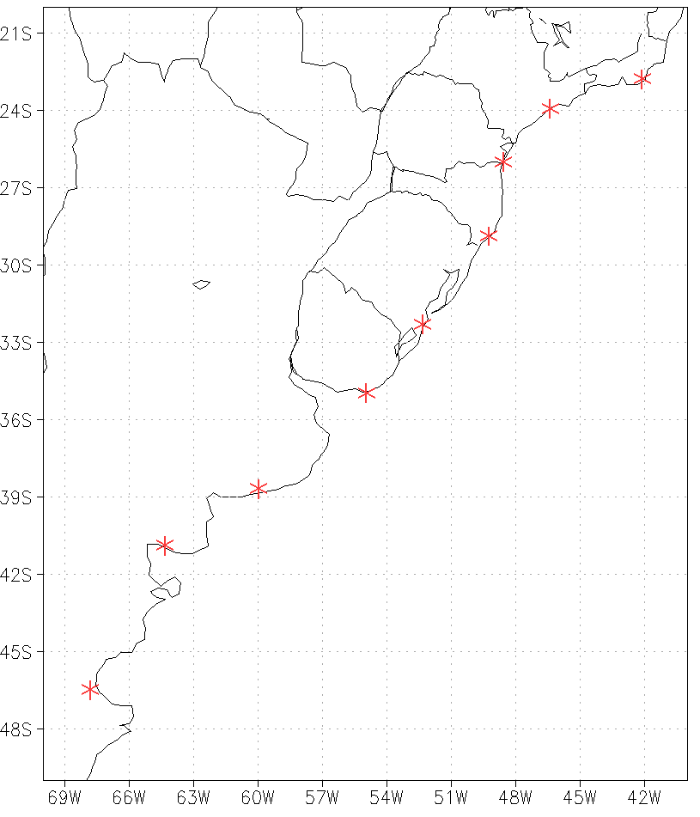
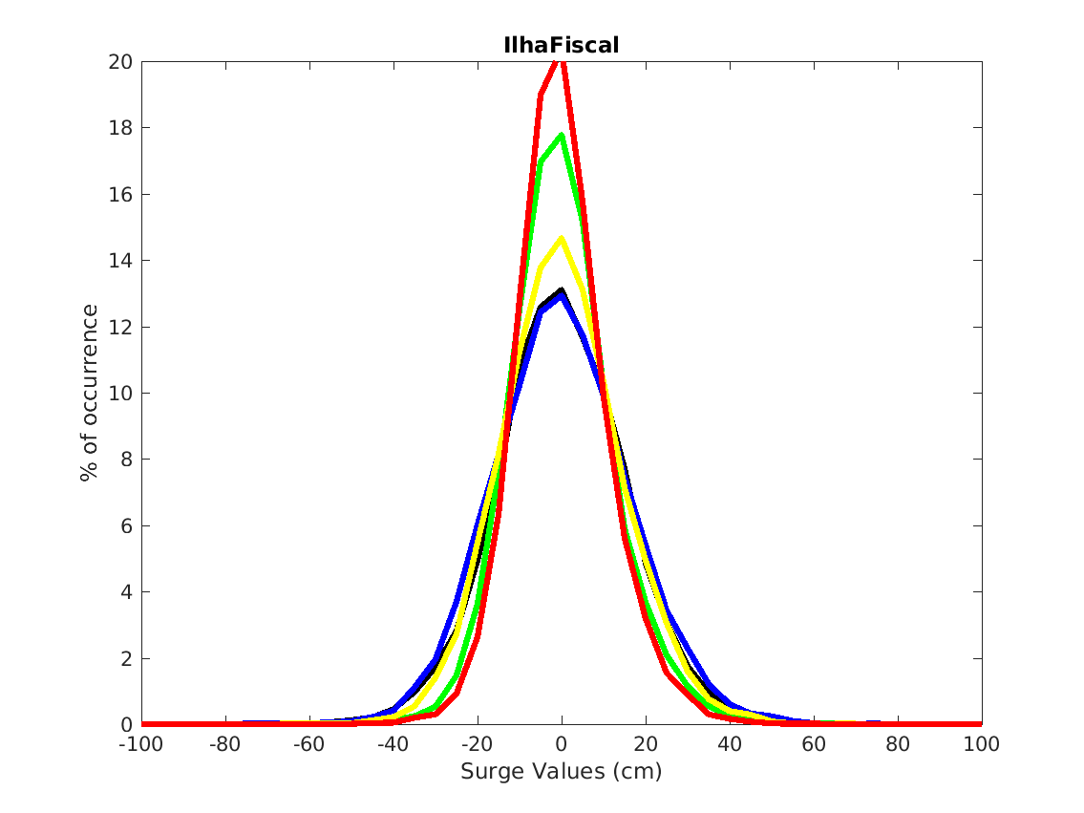
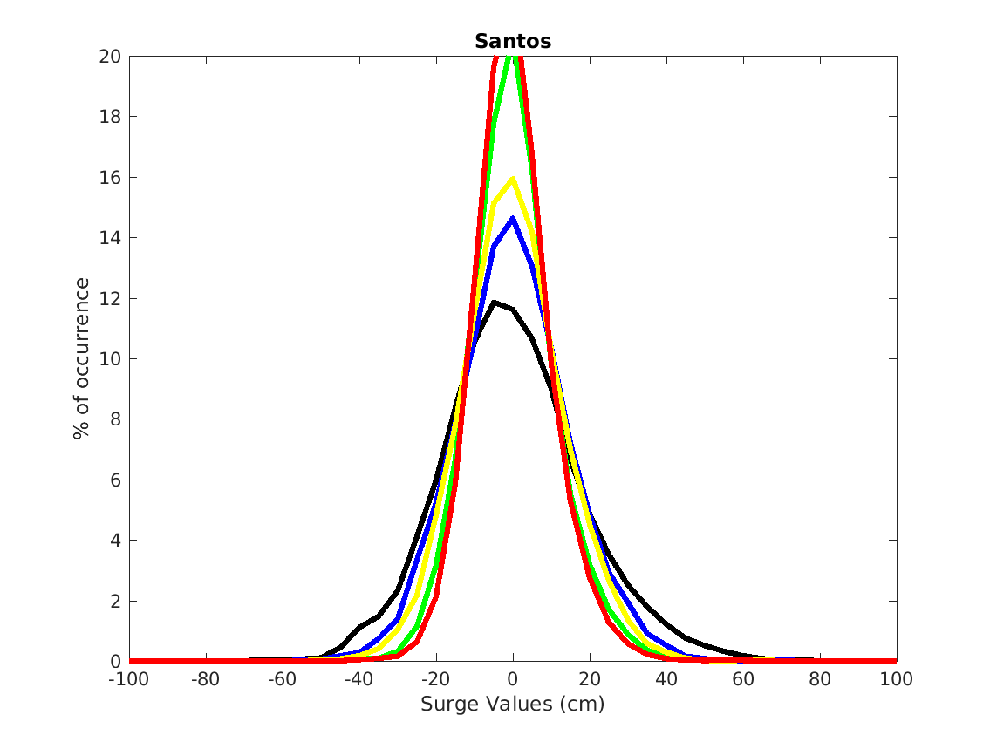
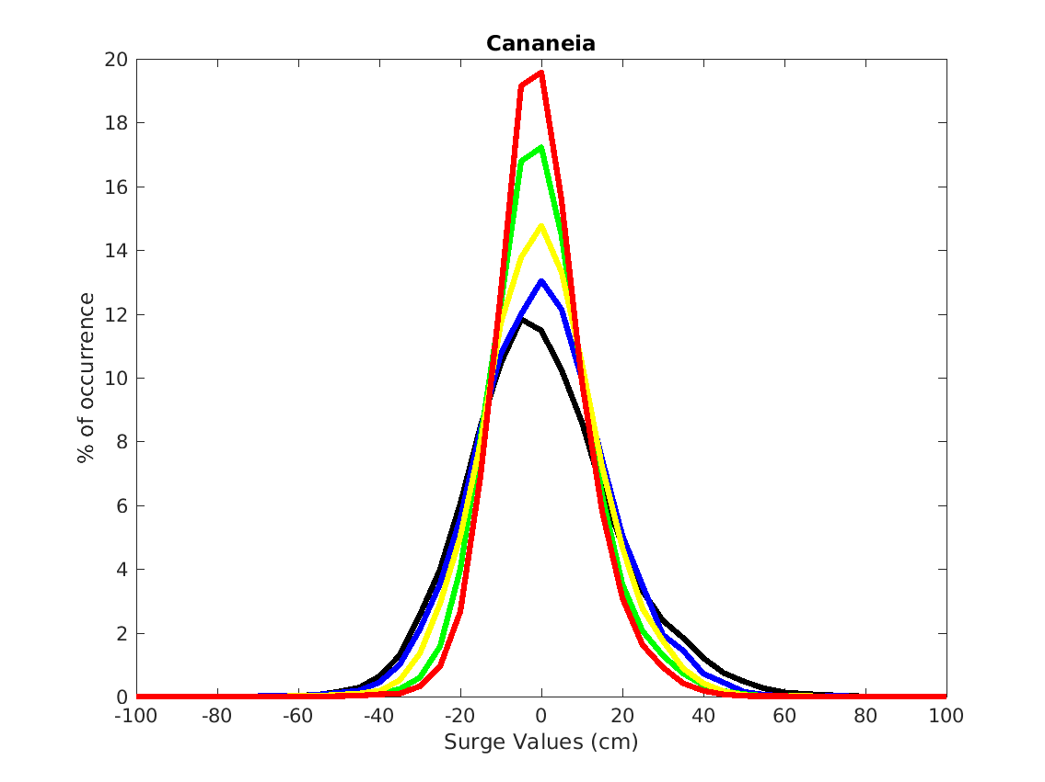
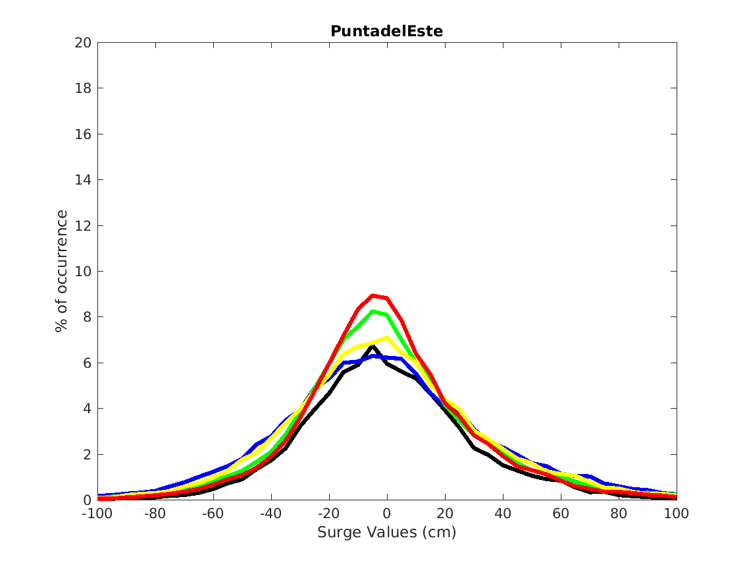
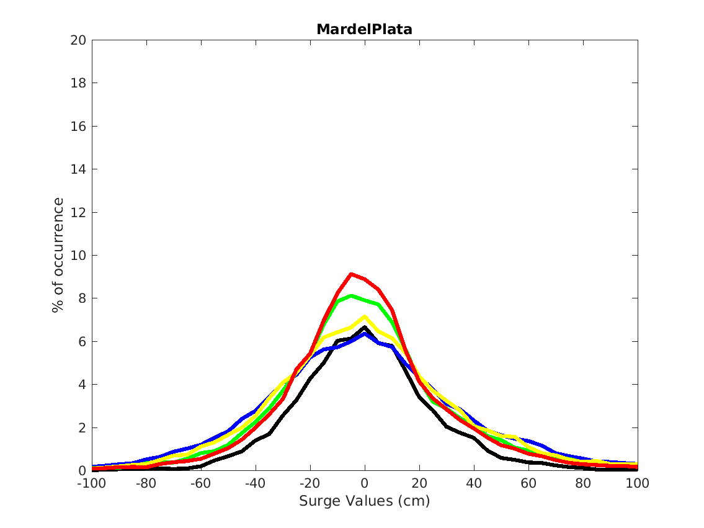
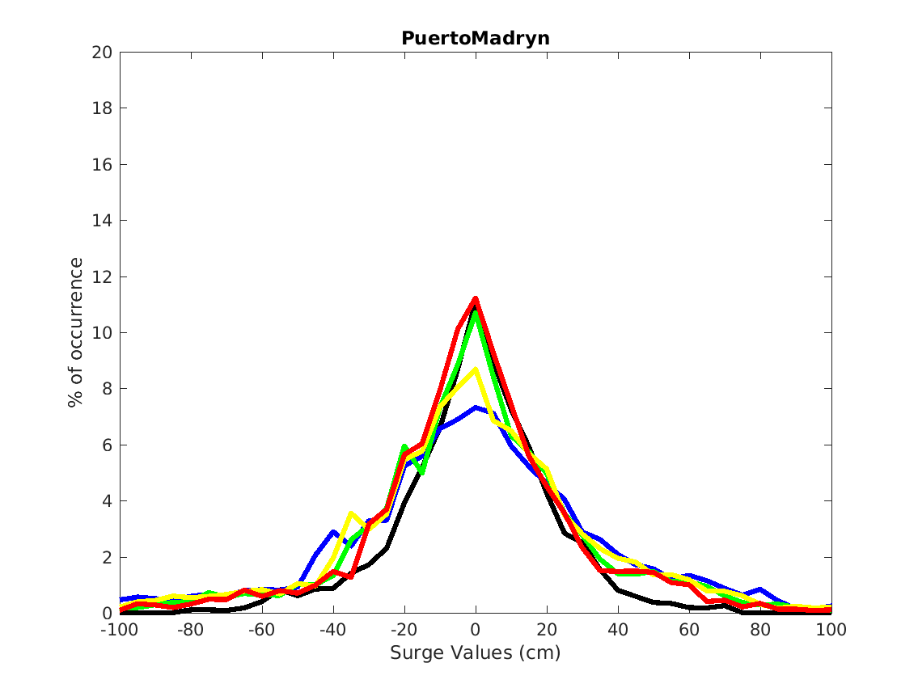
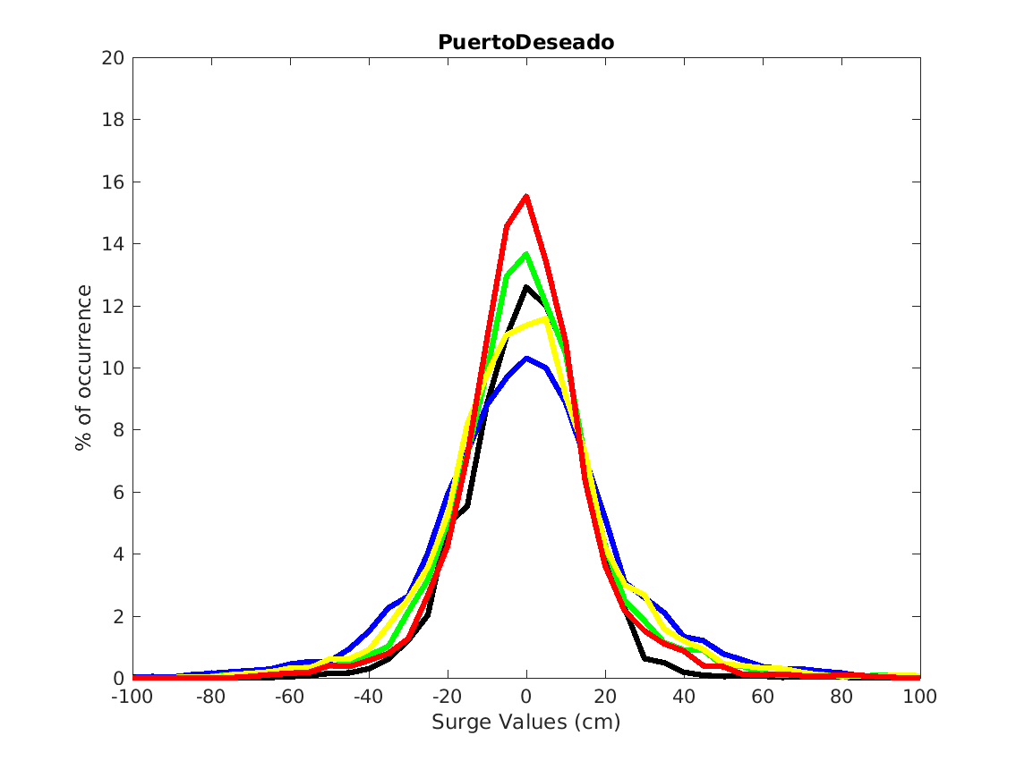
♦
♦
VALIDATION – Storm Surges
♦
♦
♦
♦
♦
Observations
Experiment 1 – W F T P
Experiment 2 – W F T
Experiment 3 – W F P
Experiment 4 – W F

Slide 12
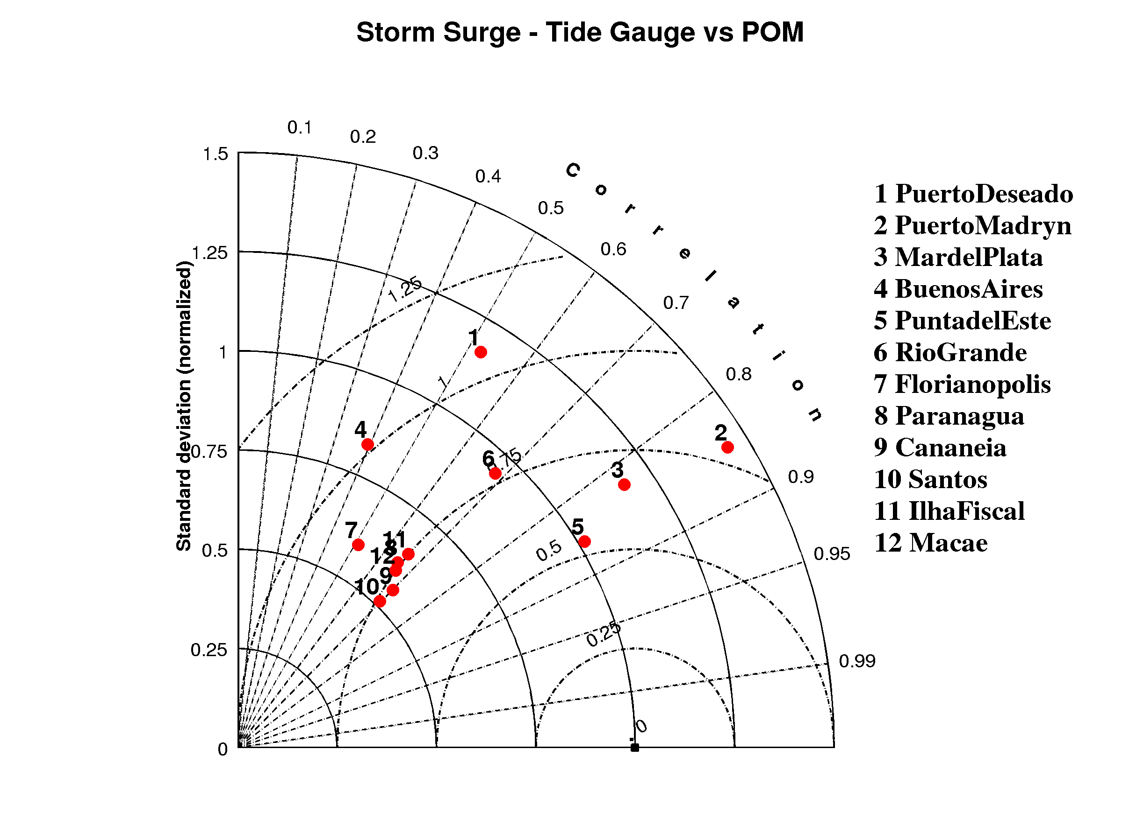
♦
♦
VALIDATION – Storm Surges – Experiment 4
♦
♦
♦
♦
♦
♦
♦

Slide 13
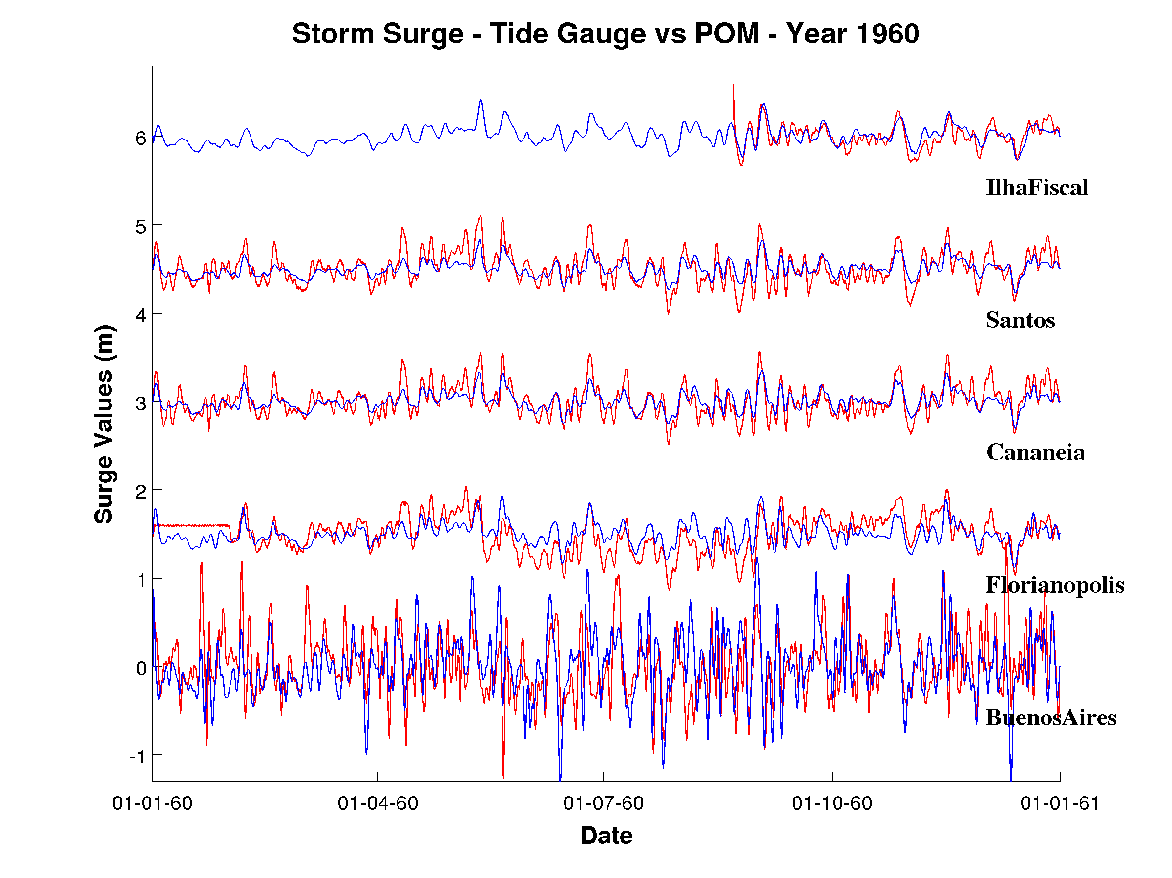
♦
VALIDATION – Storm Surges – Experiment 4
♦
♦
♦
♦
1 m
1 m
1 m
1 m
1 m

Slide 14
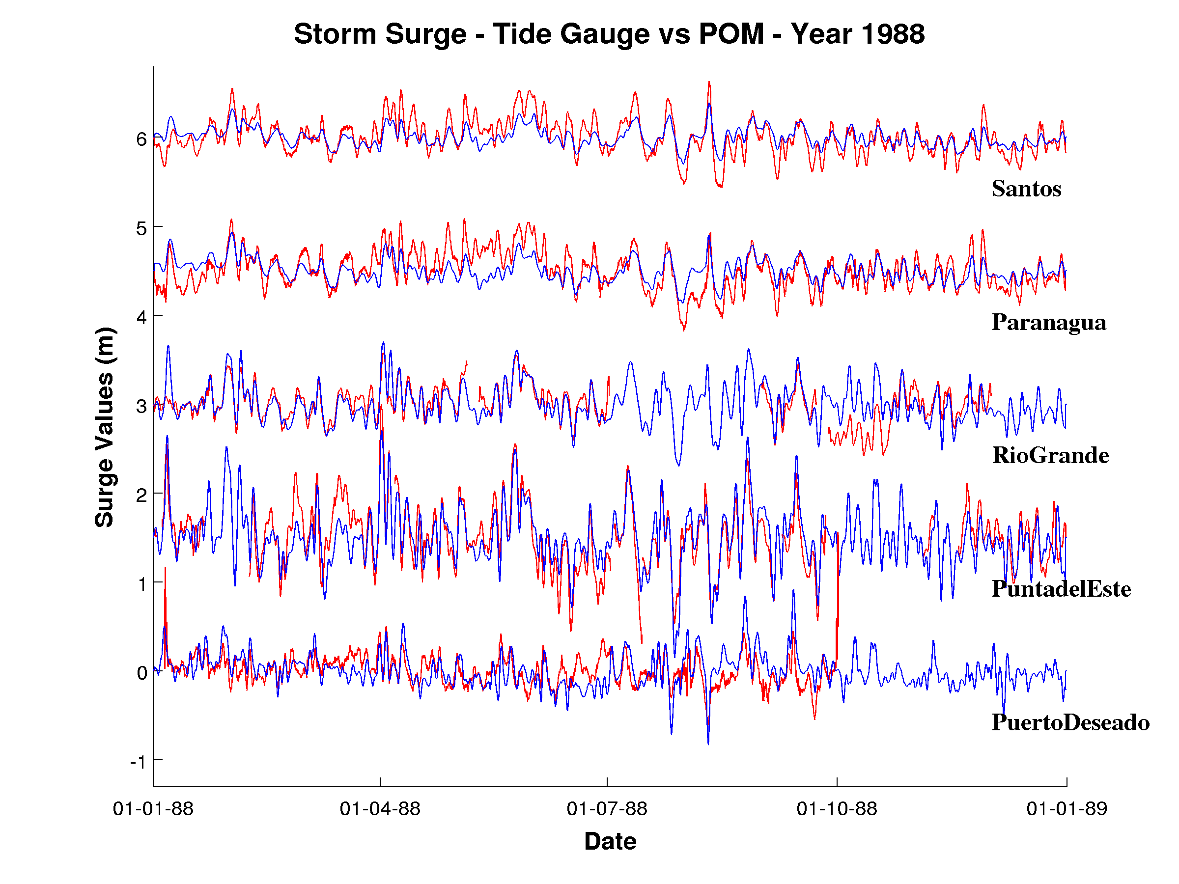
♦
VALIDATION – Storm Surges – Experiment 4
♦
♦
♦
♦
1 m
1 m
1 m
1 m
1 m

Slide 15
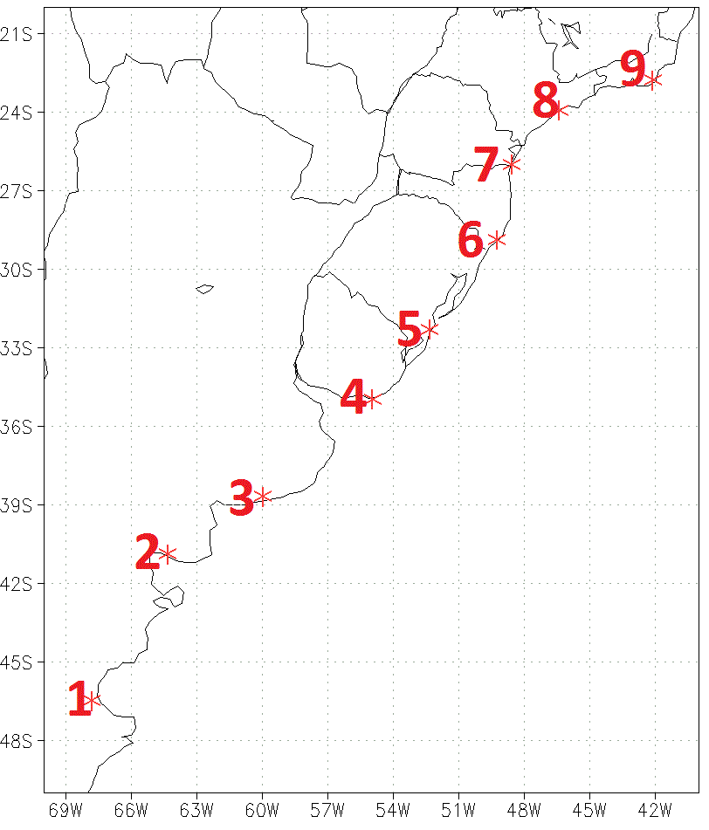
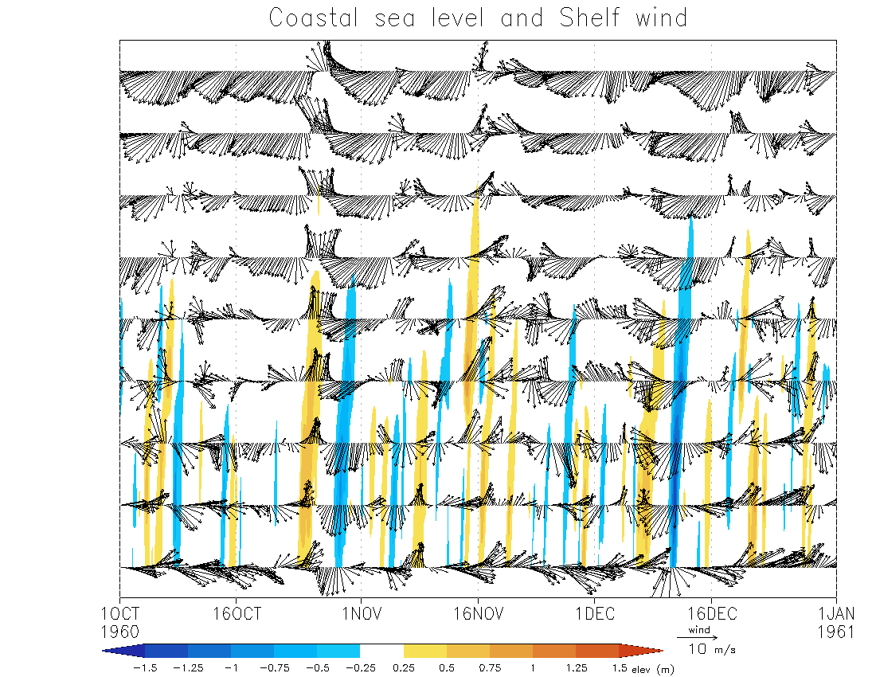
SIMULTANEOUS FIELDS – Coastal elevation
Shelf wind – Experiment 4
9
8
7
6
5
4
3
2
1

Slide 16
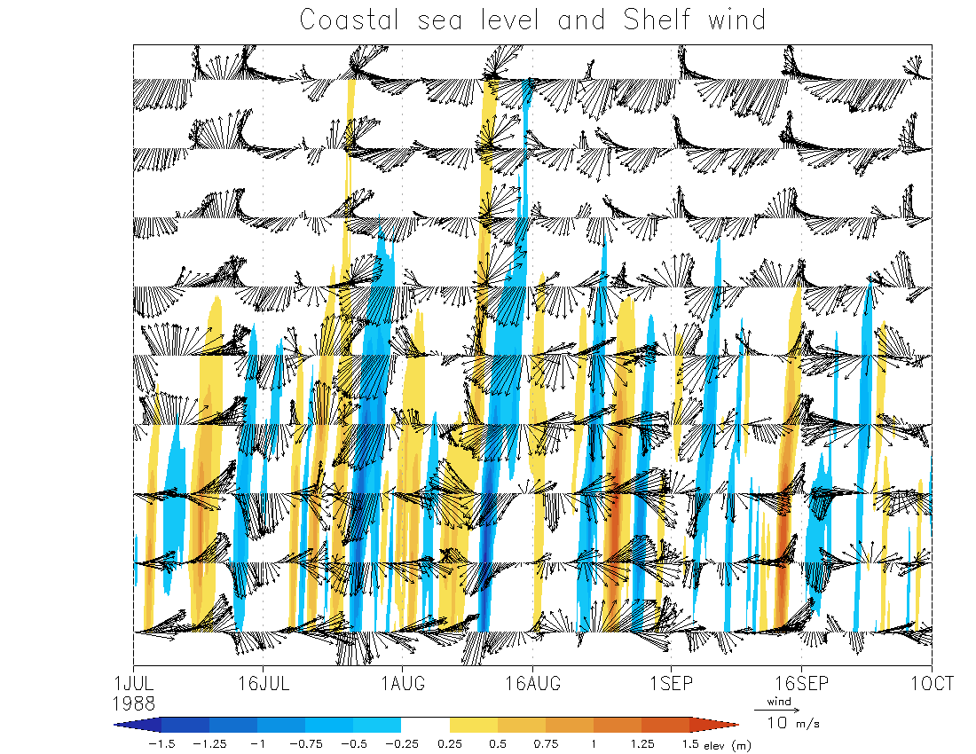
SIMULTANEOUS FIELDS – Coastal elevation
Shelf wind – Experiment 4
9
8
7
6
5
4
3
2
1

Slide 17
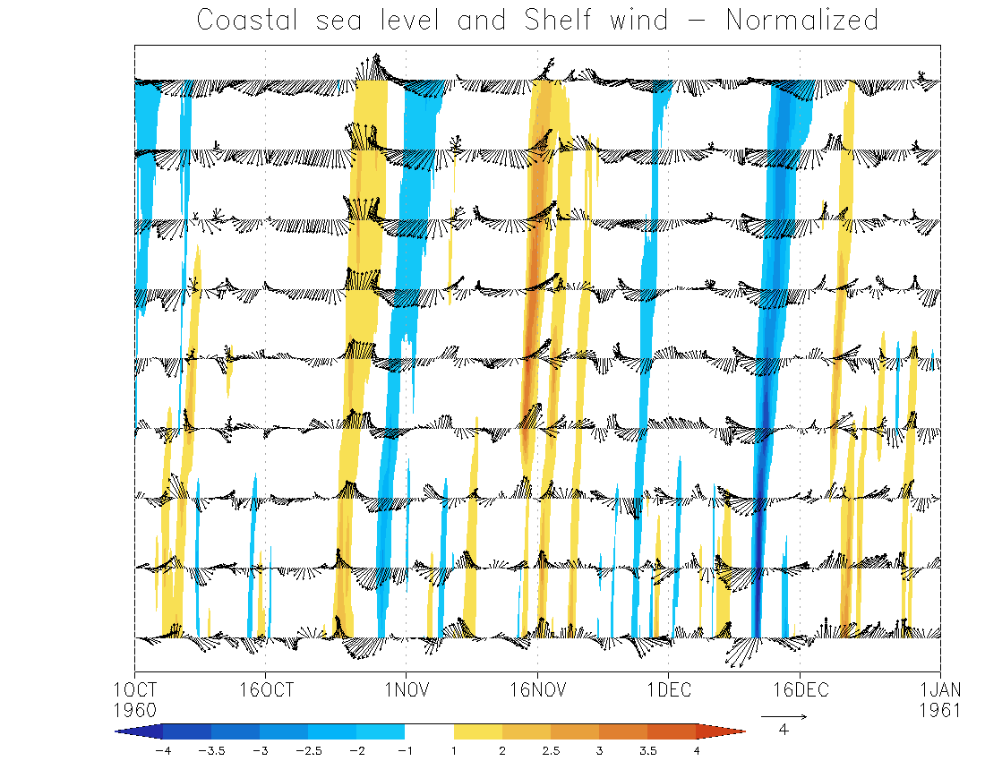
SIMULTANEOUS NORMALIZED FIELDS
Coastal elevation & Shelf wind – Experiment 4
9
8
7
6
5
4
3
2
1

Slide 18
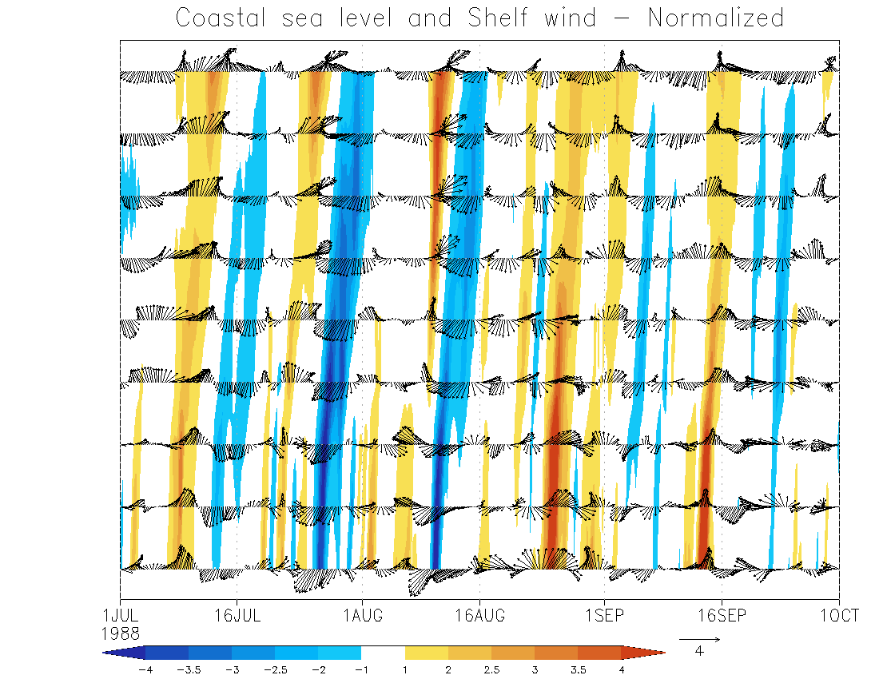
SIMULTANEOUS NORMALIZED FIELDS
Coastal elevation & Shelf wind – Experiment 4
9
8
7
6
5
4
3
2
1

Slide 19
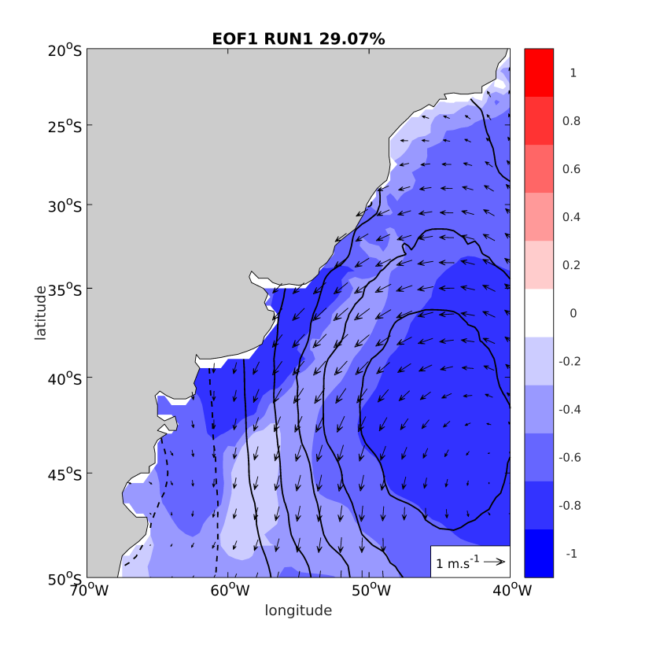
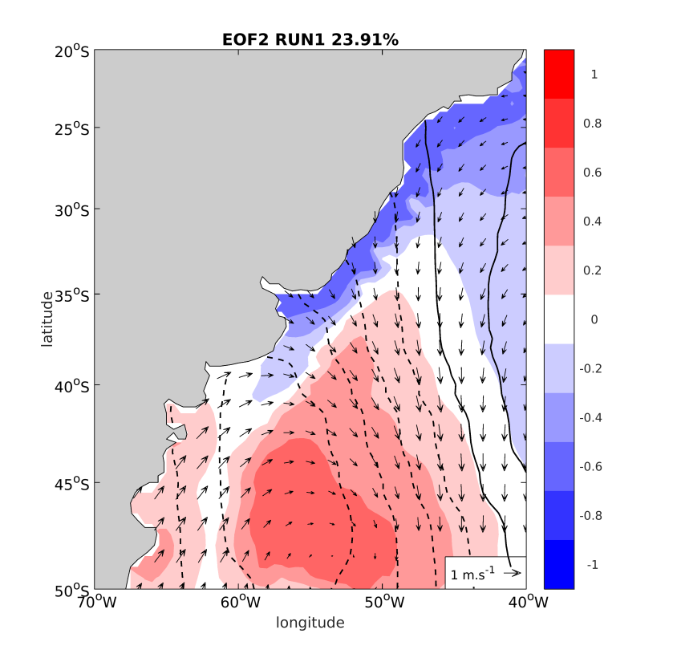
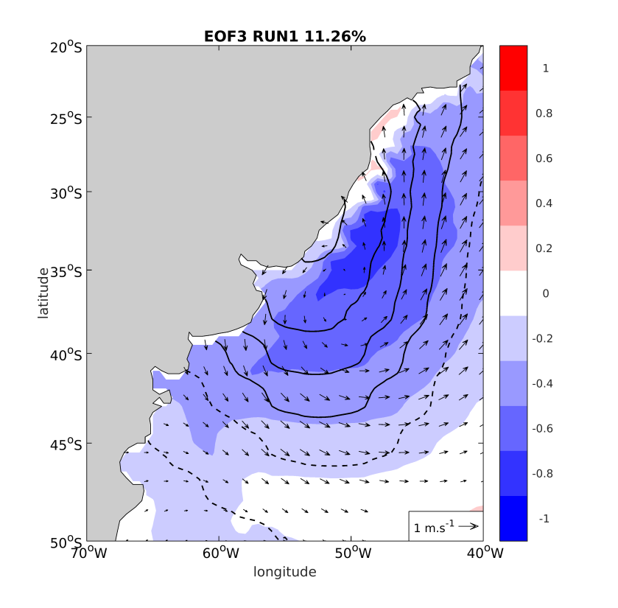
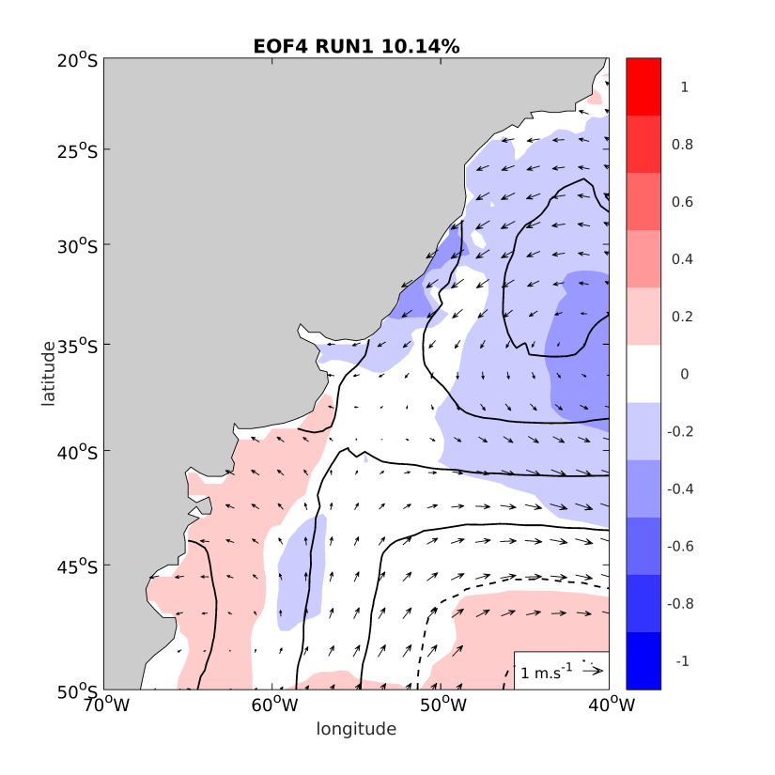
GENERATION
ASPECTS
EXPERIMENT1

Slide 20
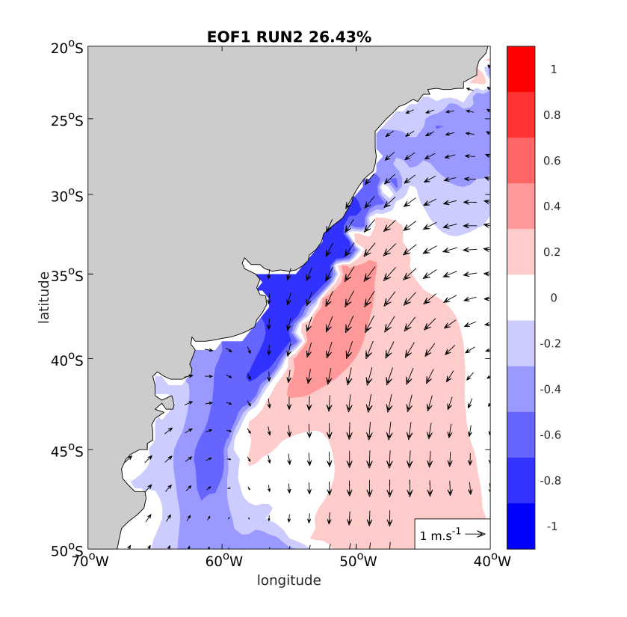
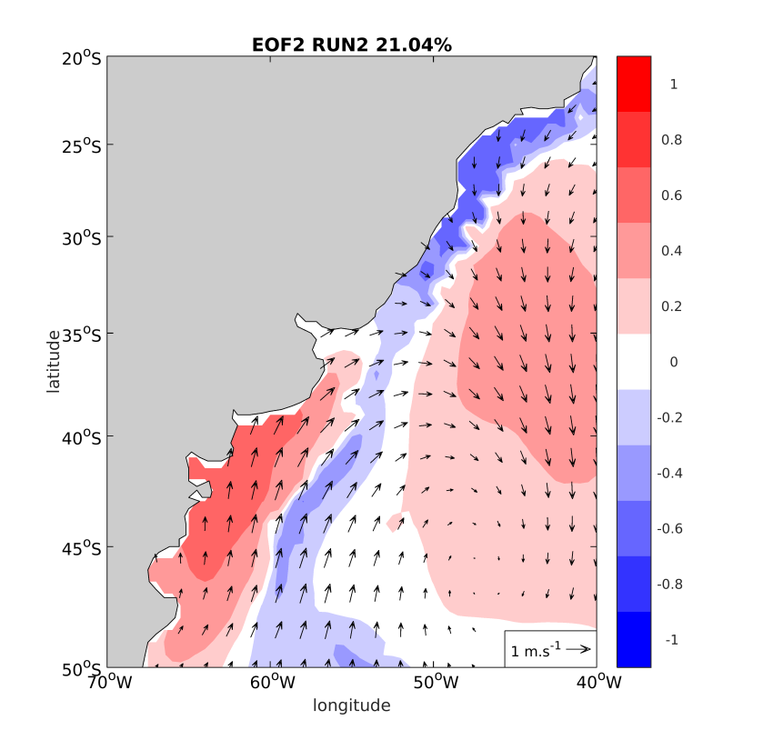
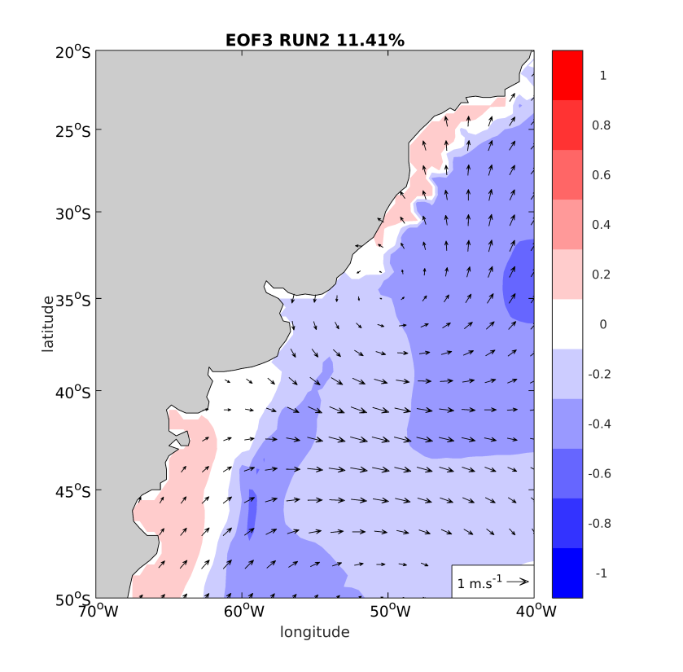
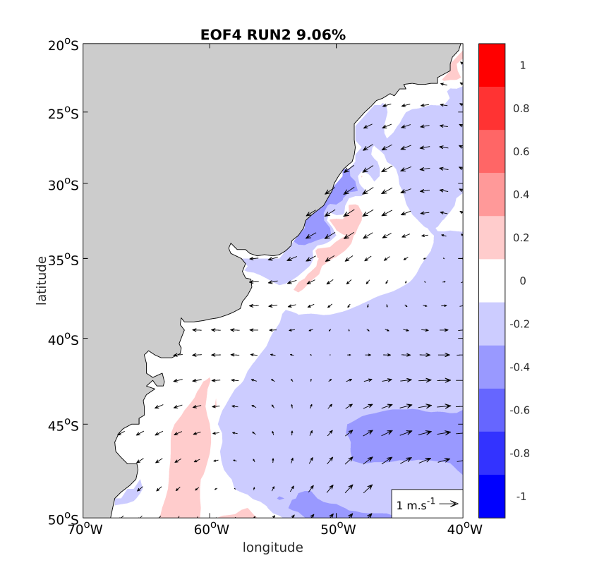
GENERATION
ASPECTS
EXPERIMENT2

Slide 21
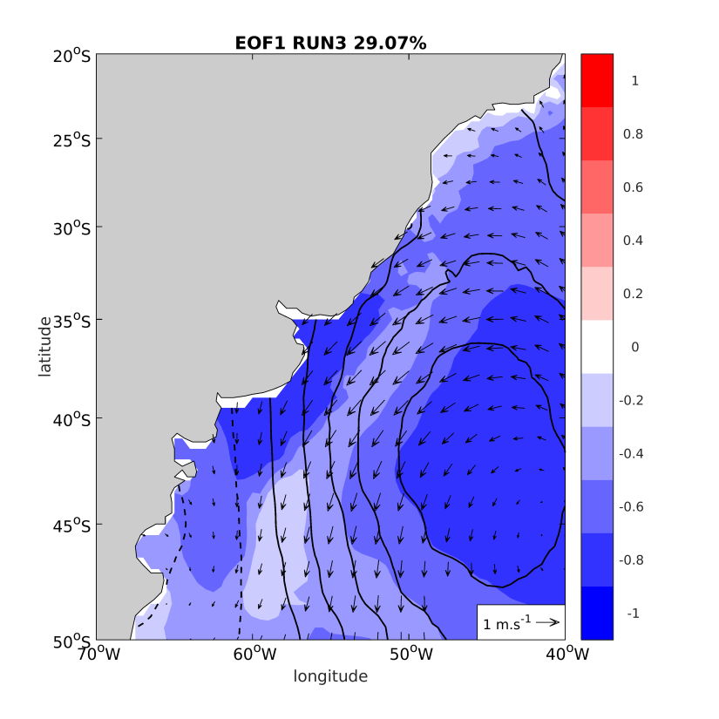
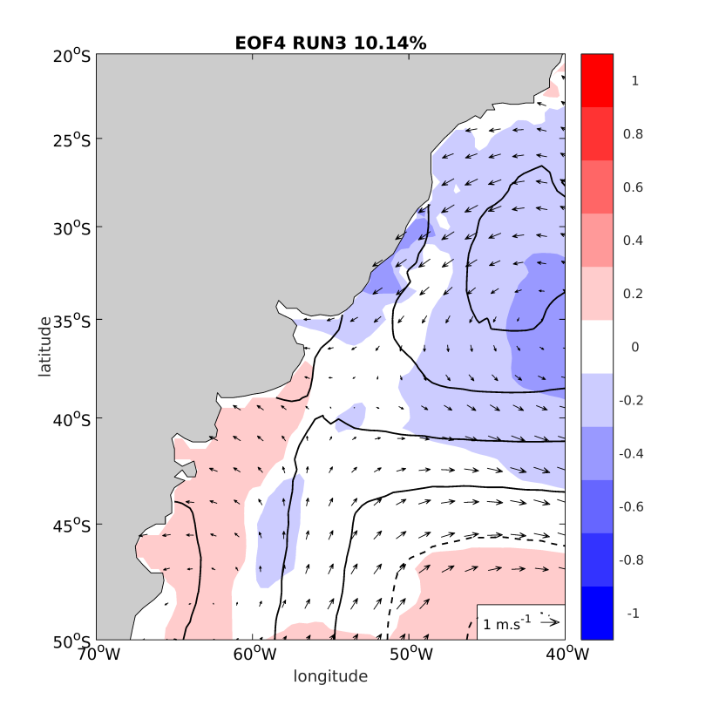
GENERATION
ASPECTS
EXPERIMENT3

Slide 22
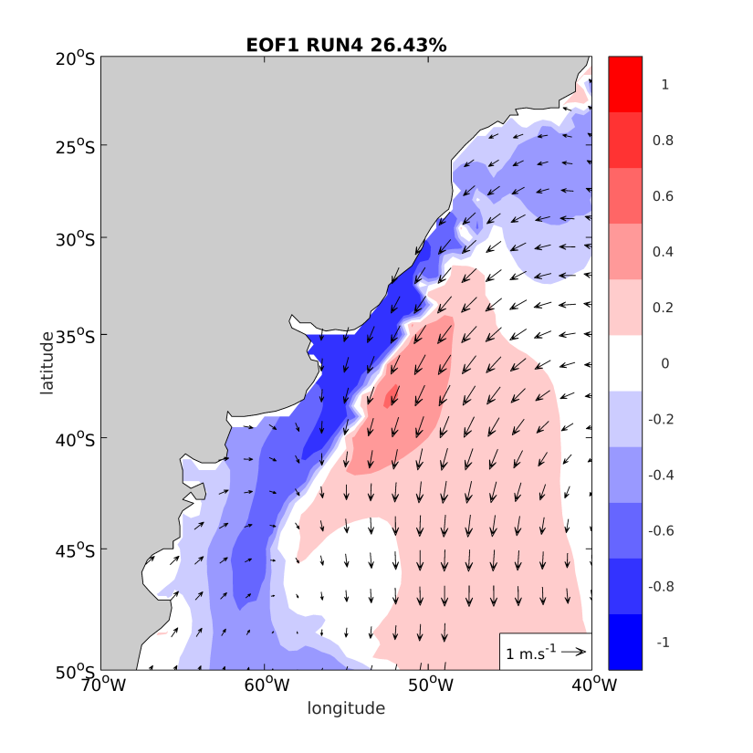
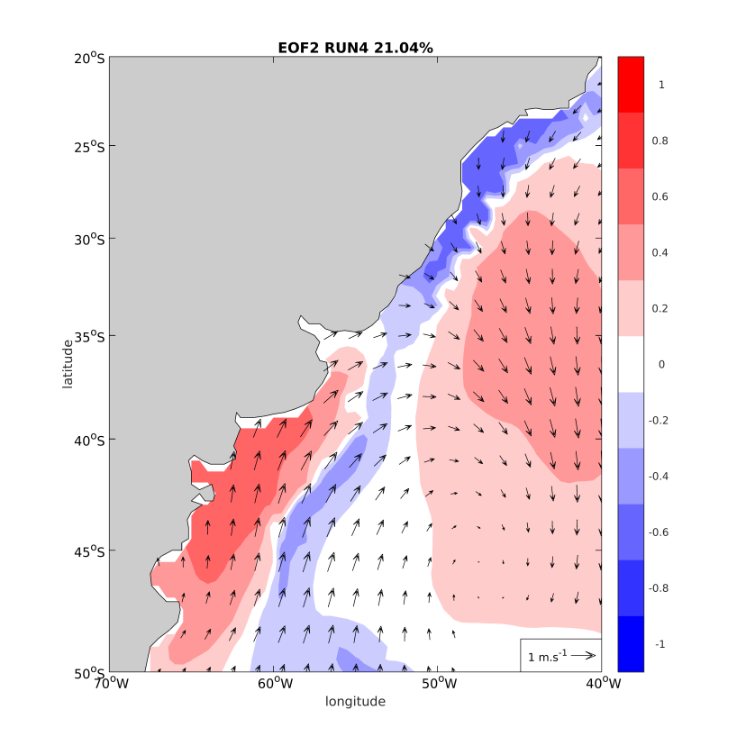
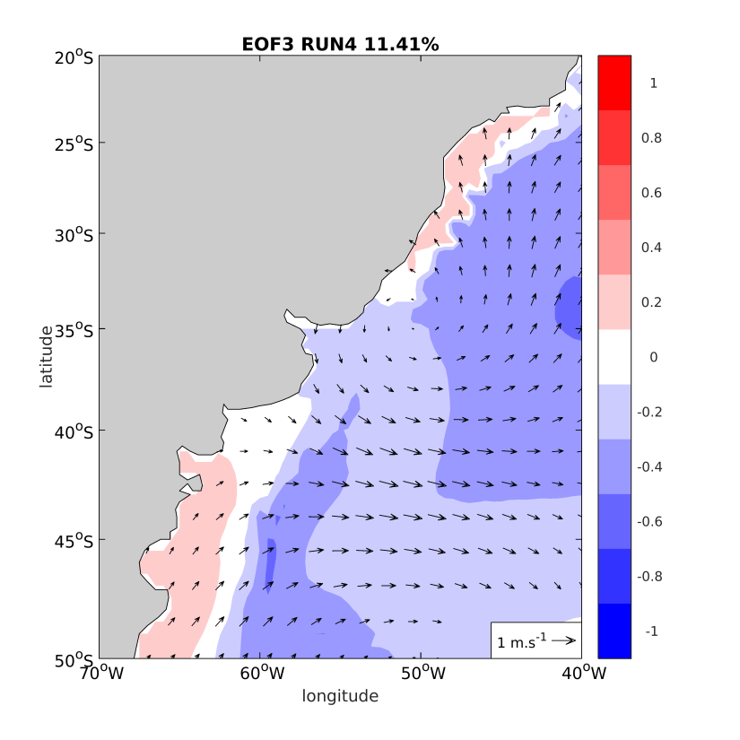
GENERATION
ASPECTS
EXPERIMENT4

Slide 23
MODE EVOLUTION
EC2
EC2
-EC1
-EC1
December, 07 to 17, 1960
August, 21 to 31, 1988

Slide 24
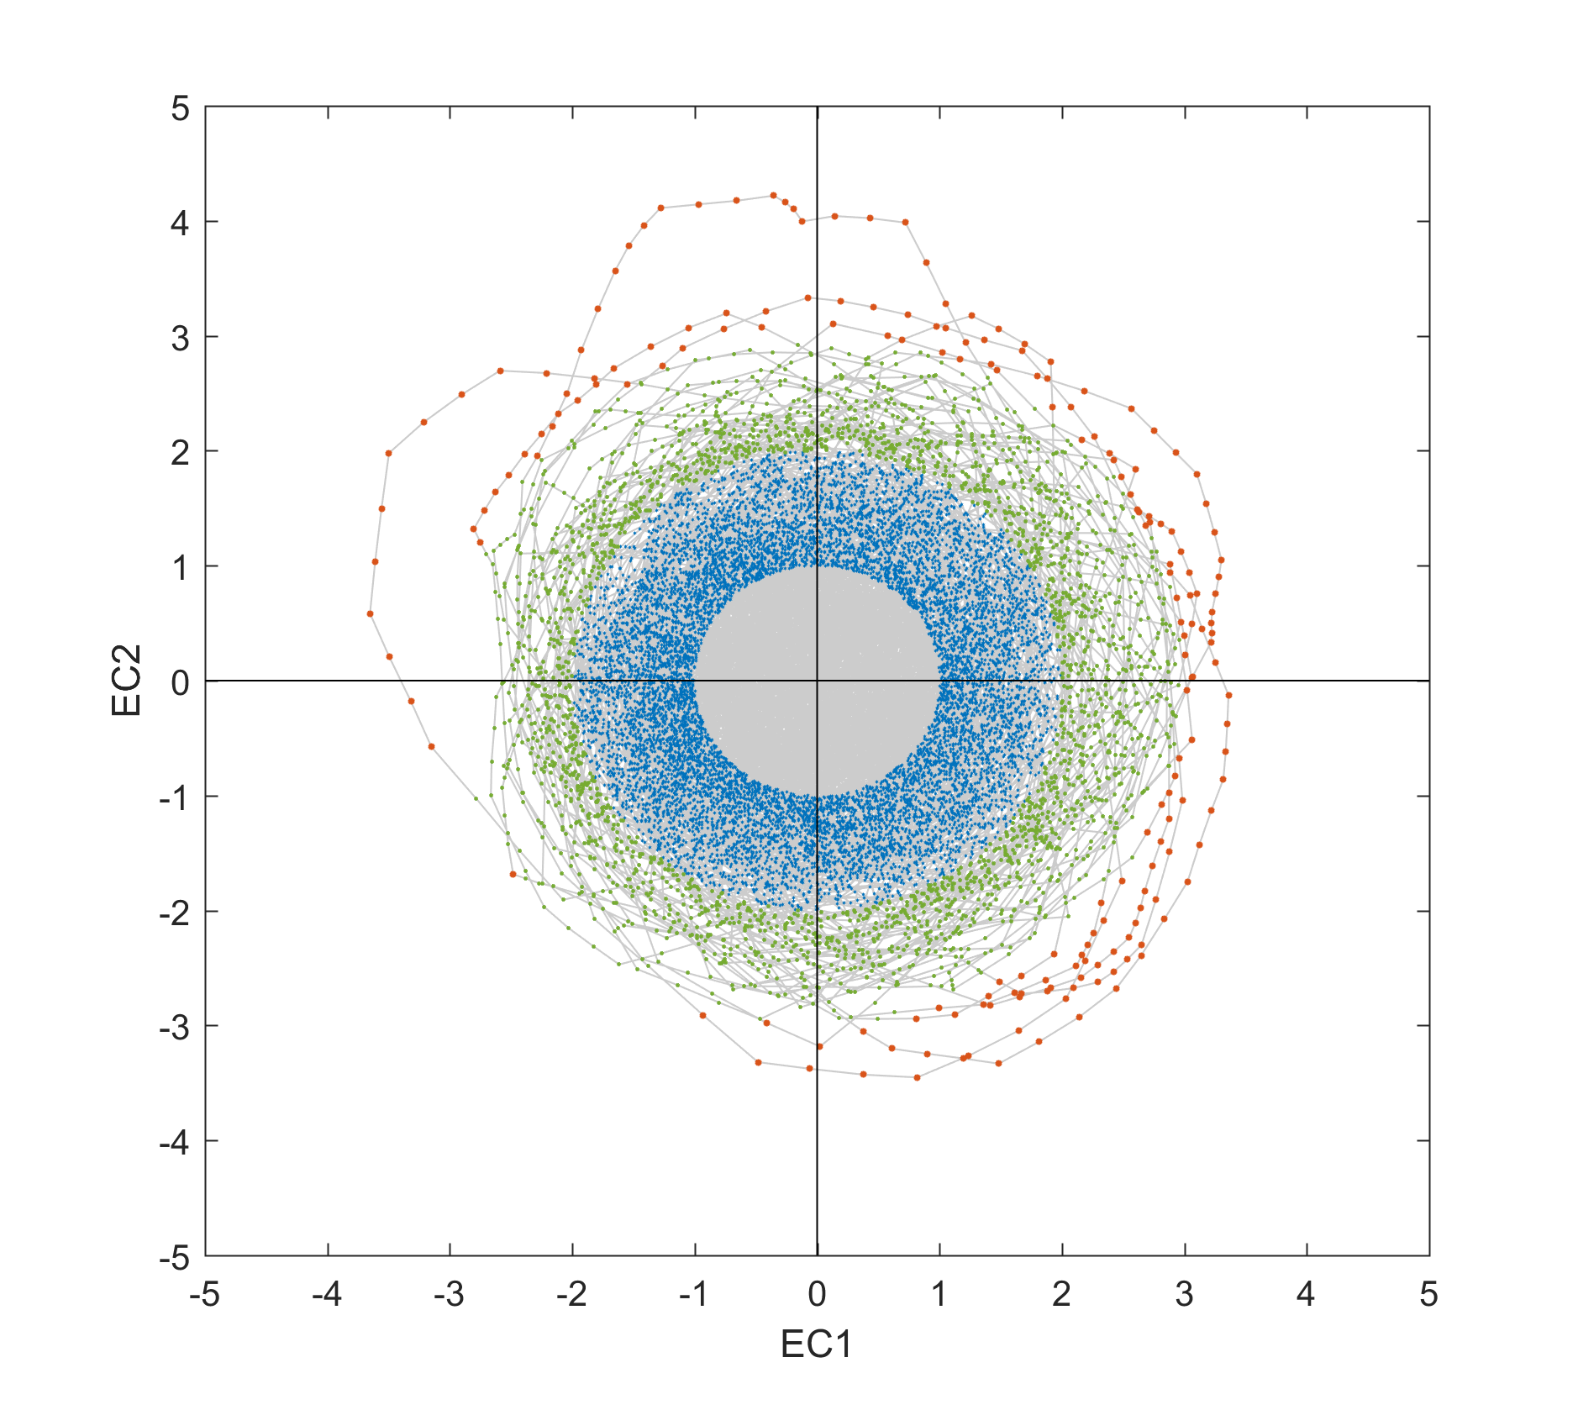
PROPAGATION ASPECTS
A
H
B
G
C
F
D
E

Slide 25
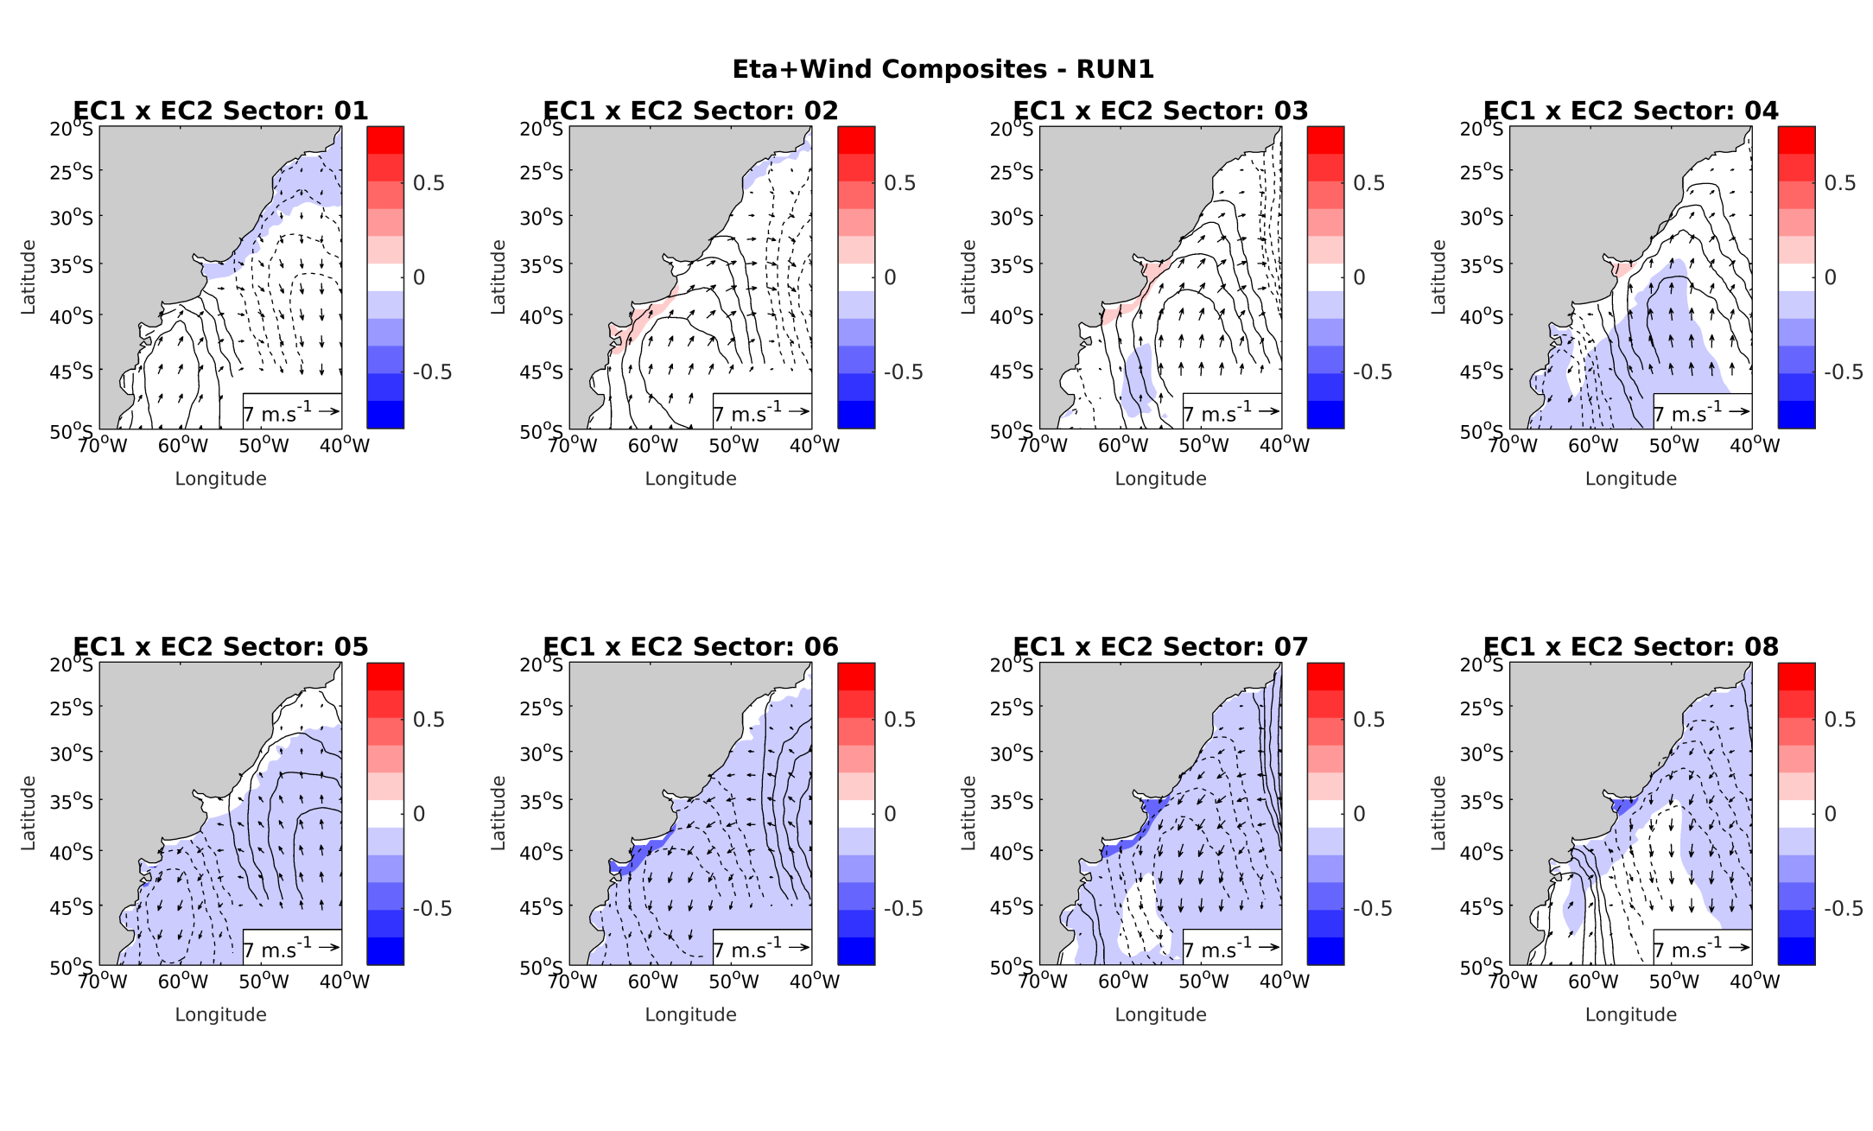
COMPOSITES RUN1 ALL POINTS

Slide 26
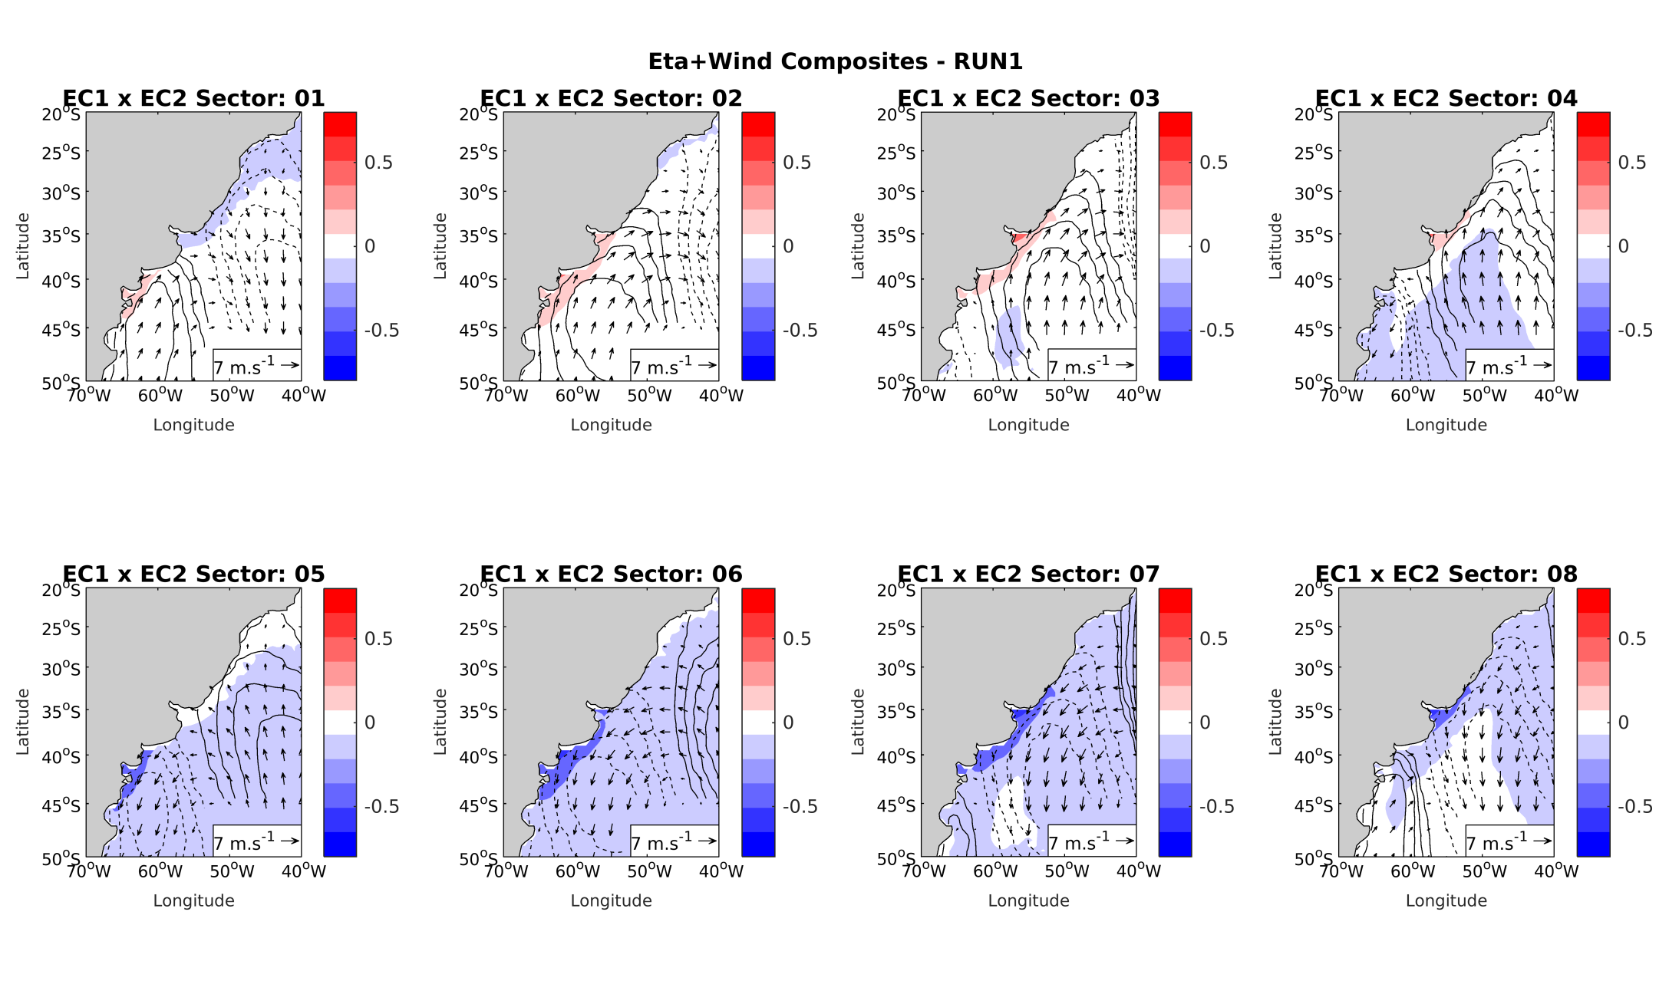
COMPOSITES RUN1 1std

Slide 27
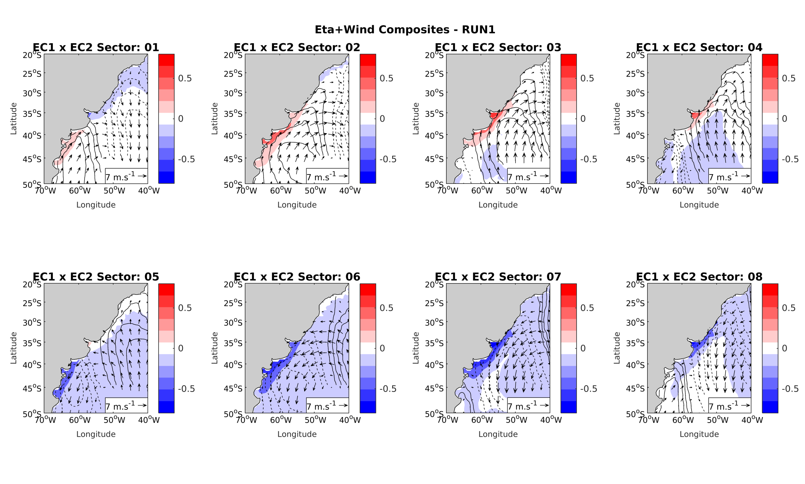
COMPOSITES RUN1 2std

Slide 28
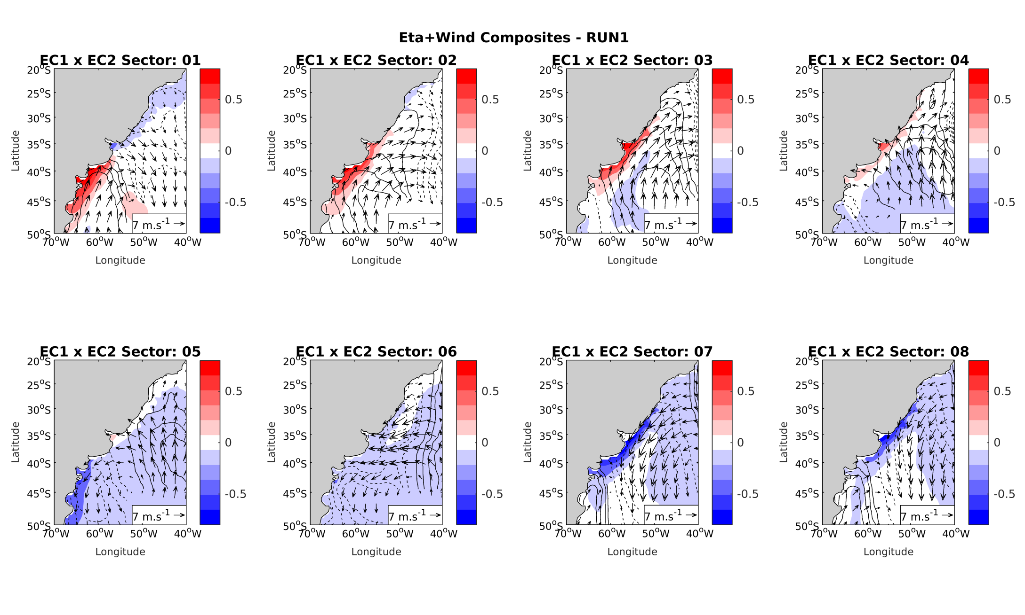
COMPOSITES RUN1 3std

Slide 29
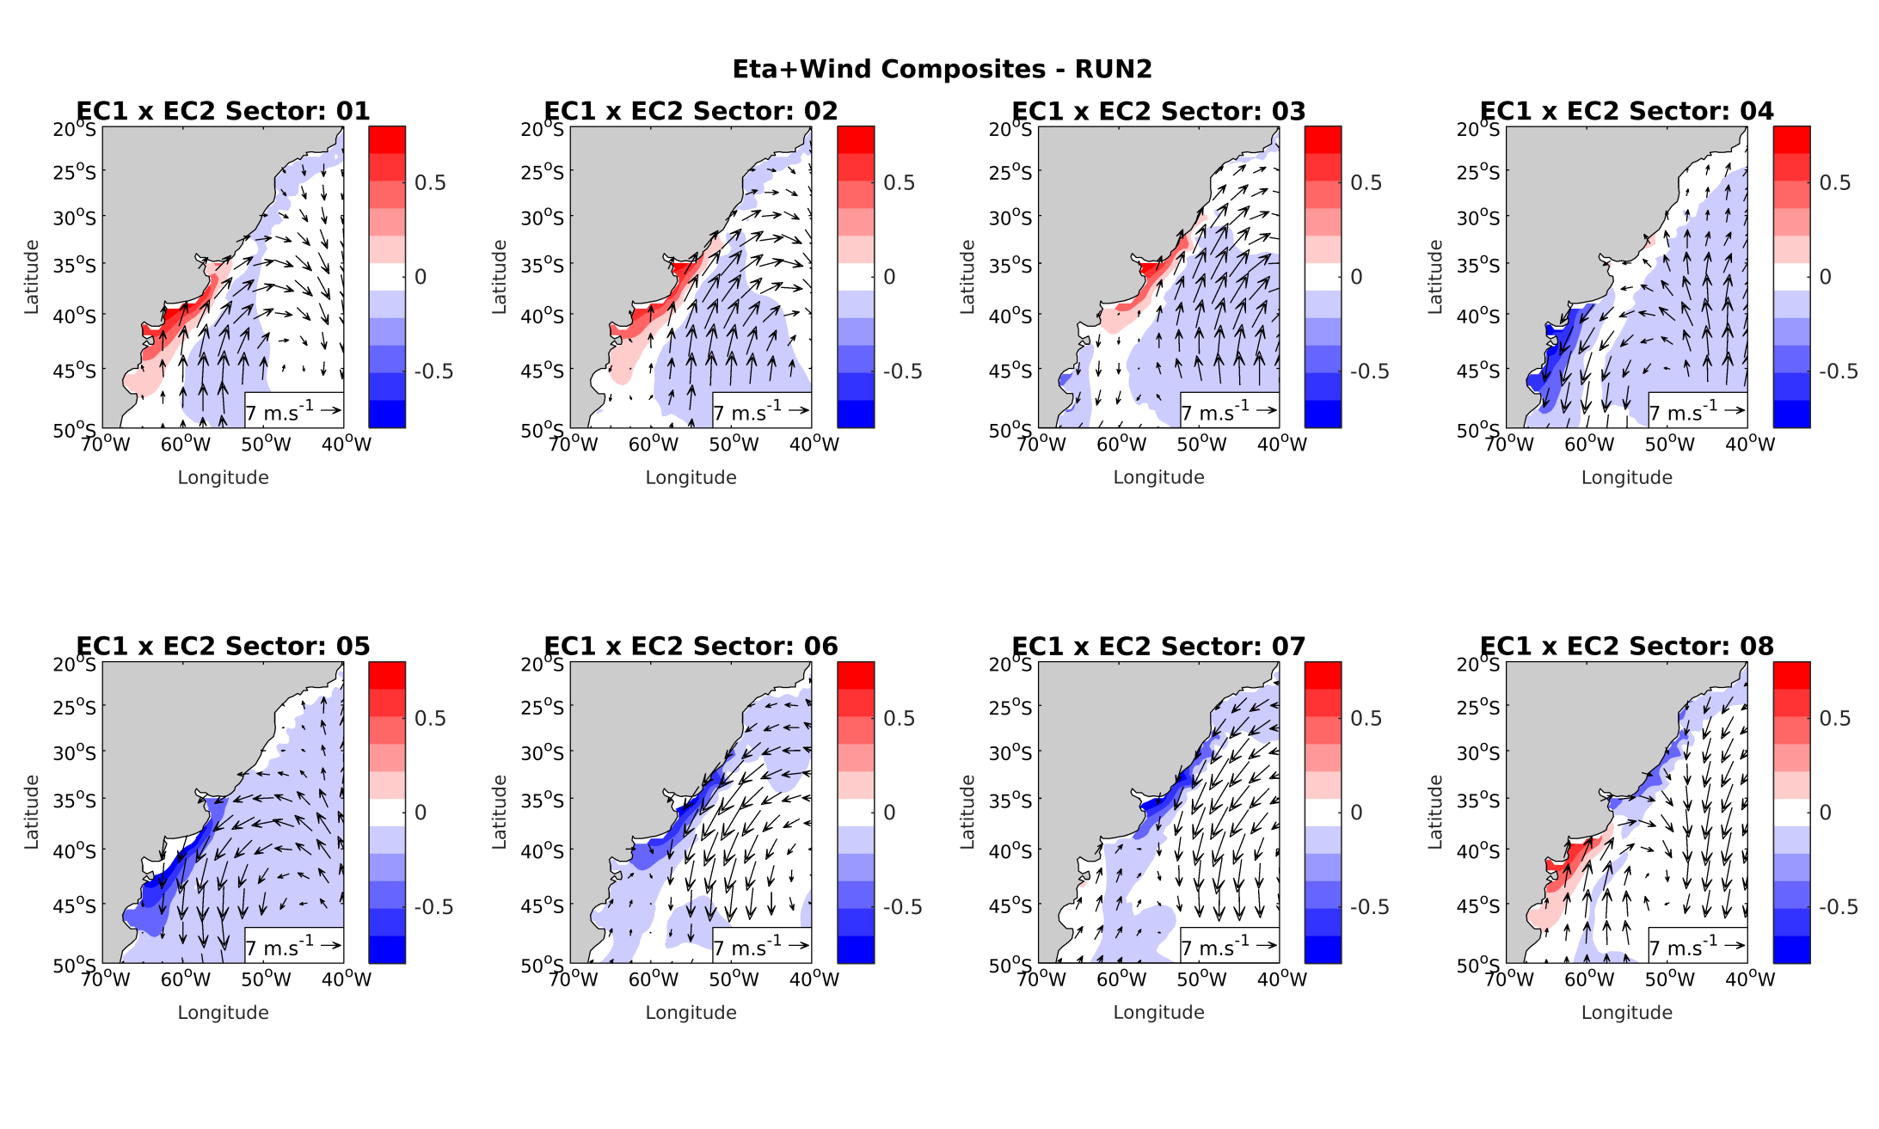
COMPOSITES RUN2 3std

Slide 30
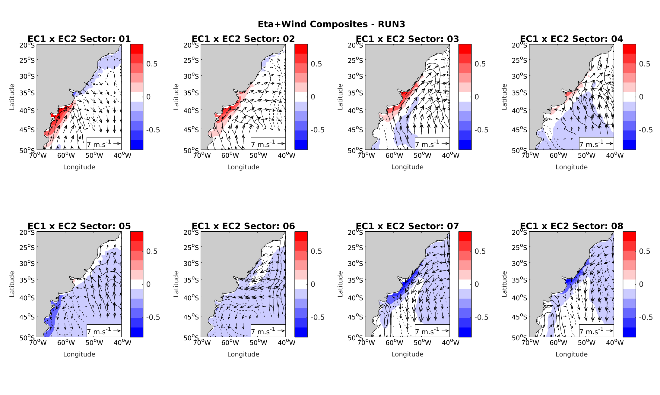
COMPOSITES RUN3 3std

Slide 31
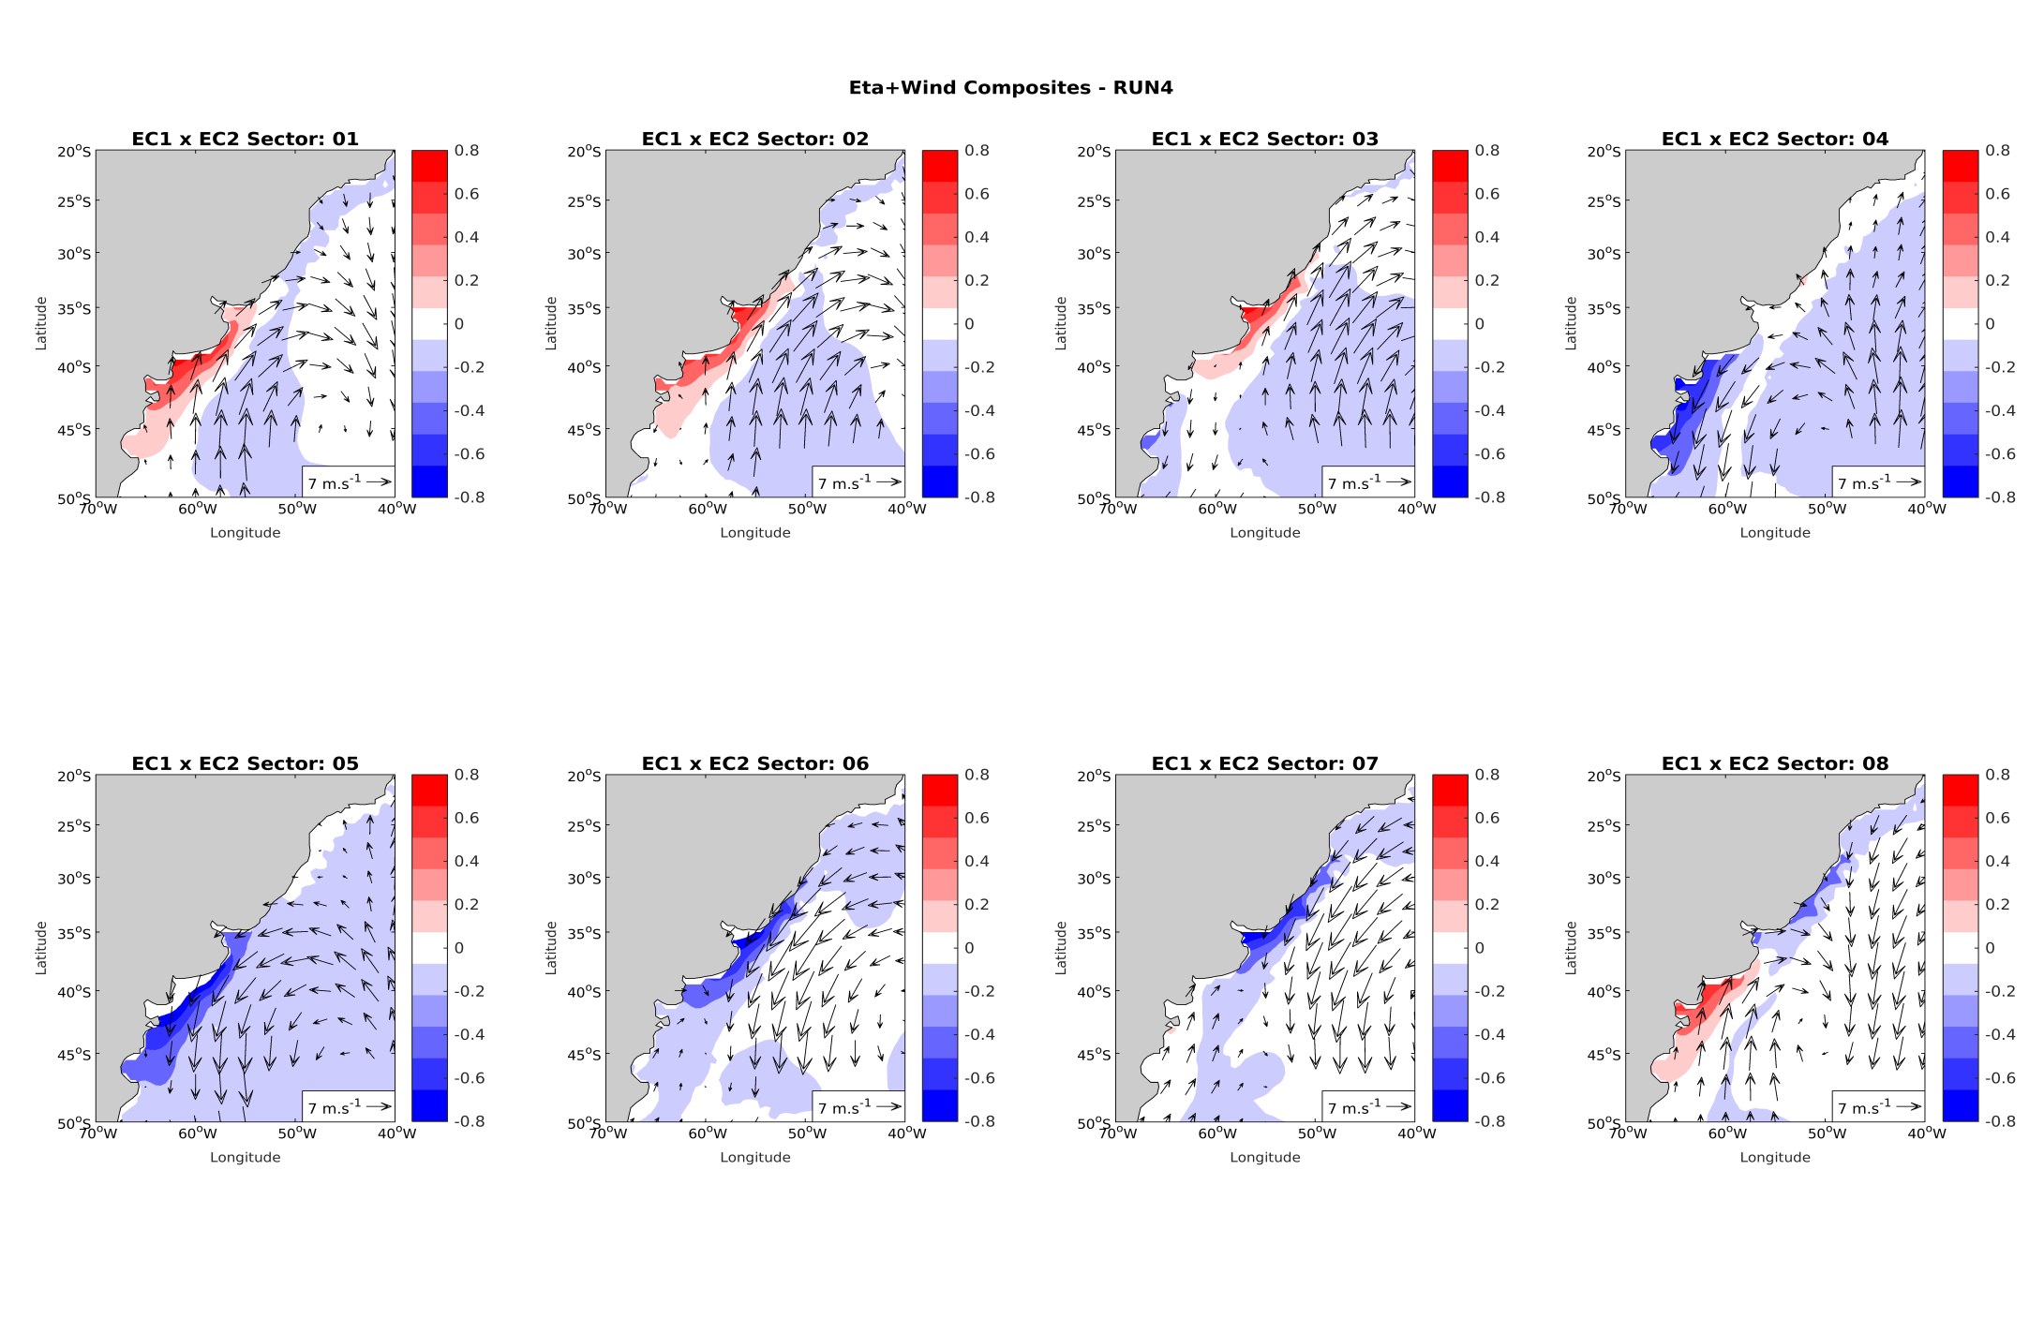
COMPOSITES RUN4 3std

Slide 32
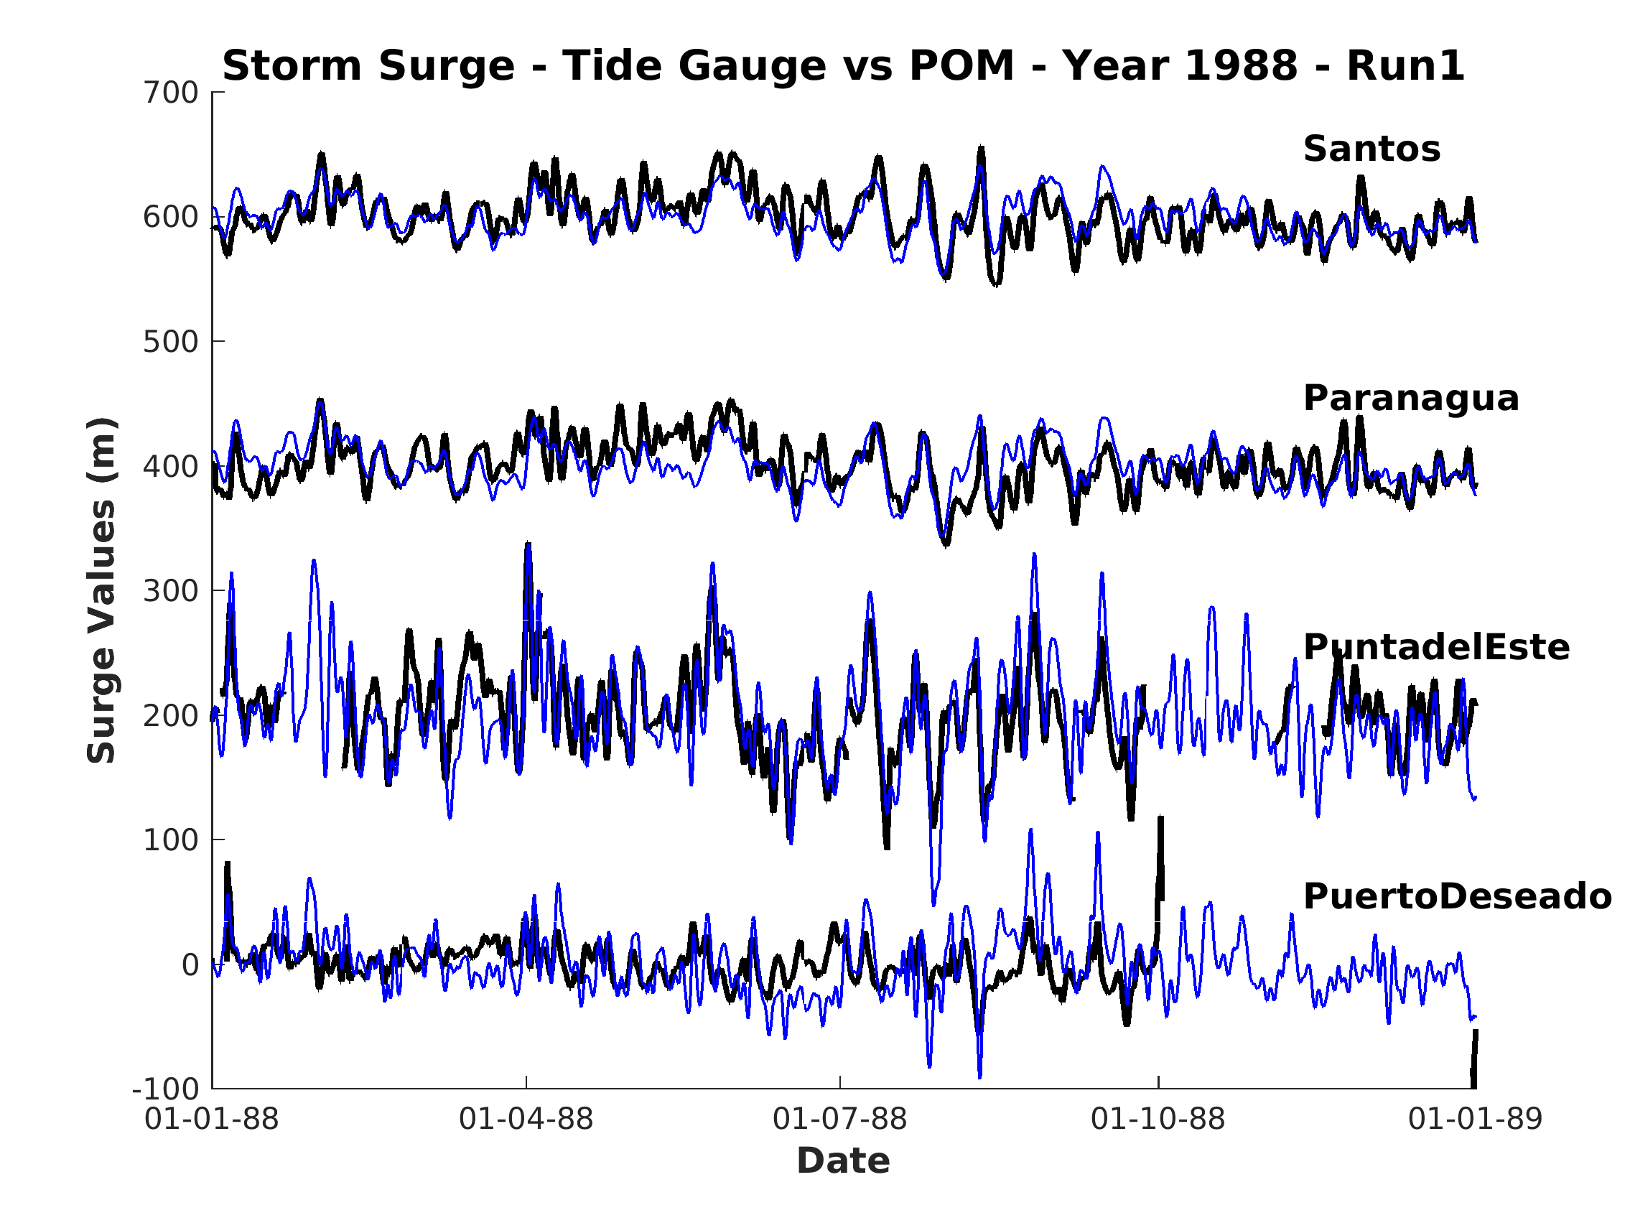
FACTOR SEPARATION

Slide 33
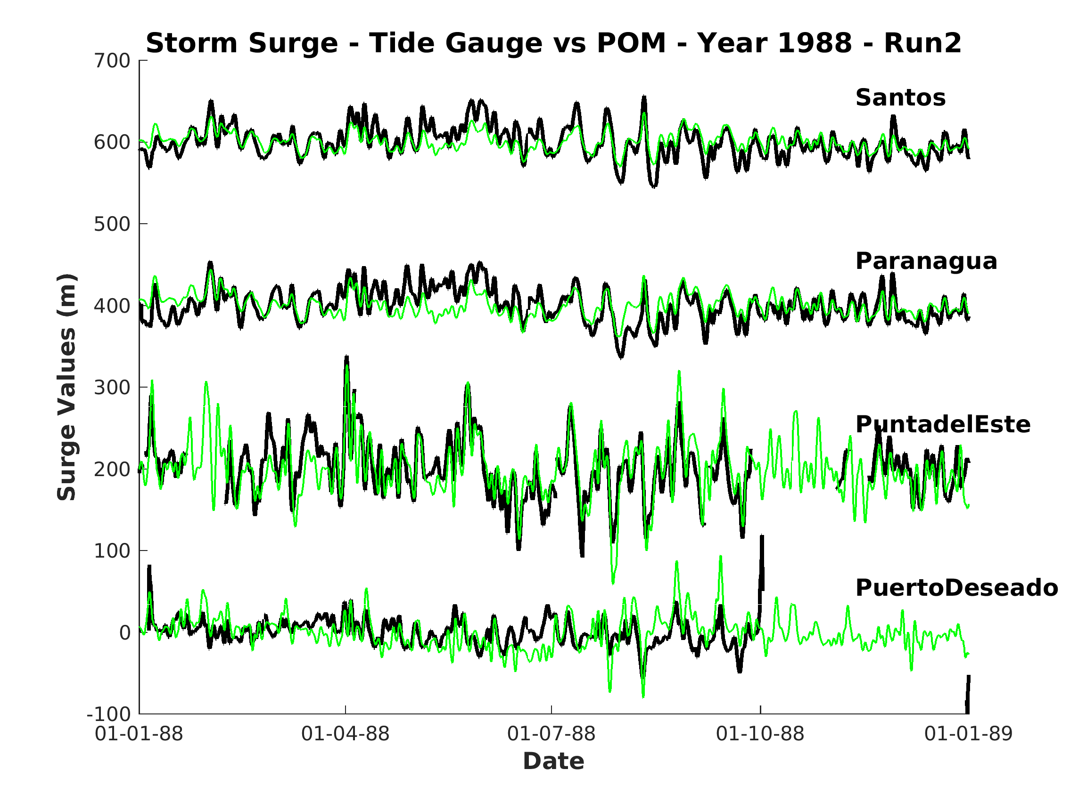
FACTOR SEPARATION

Slide 34
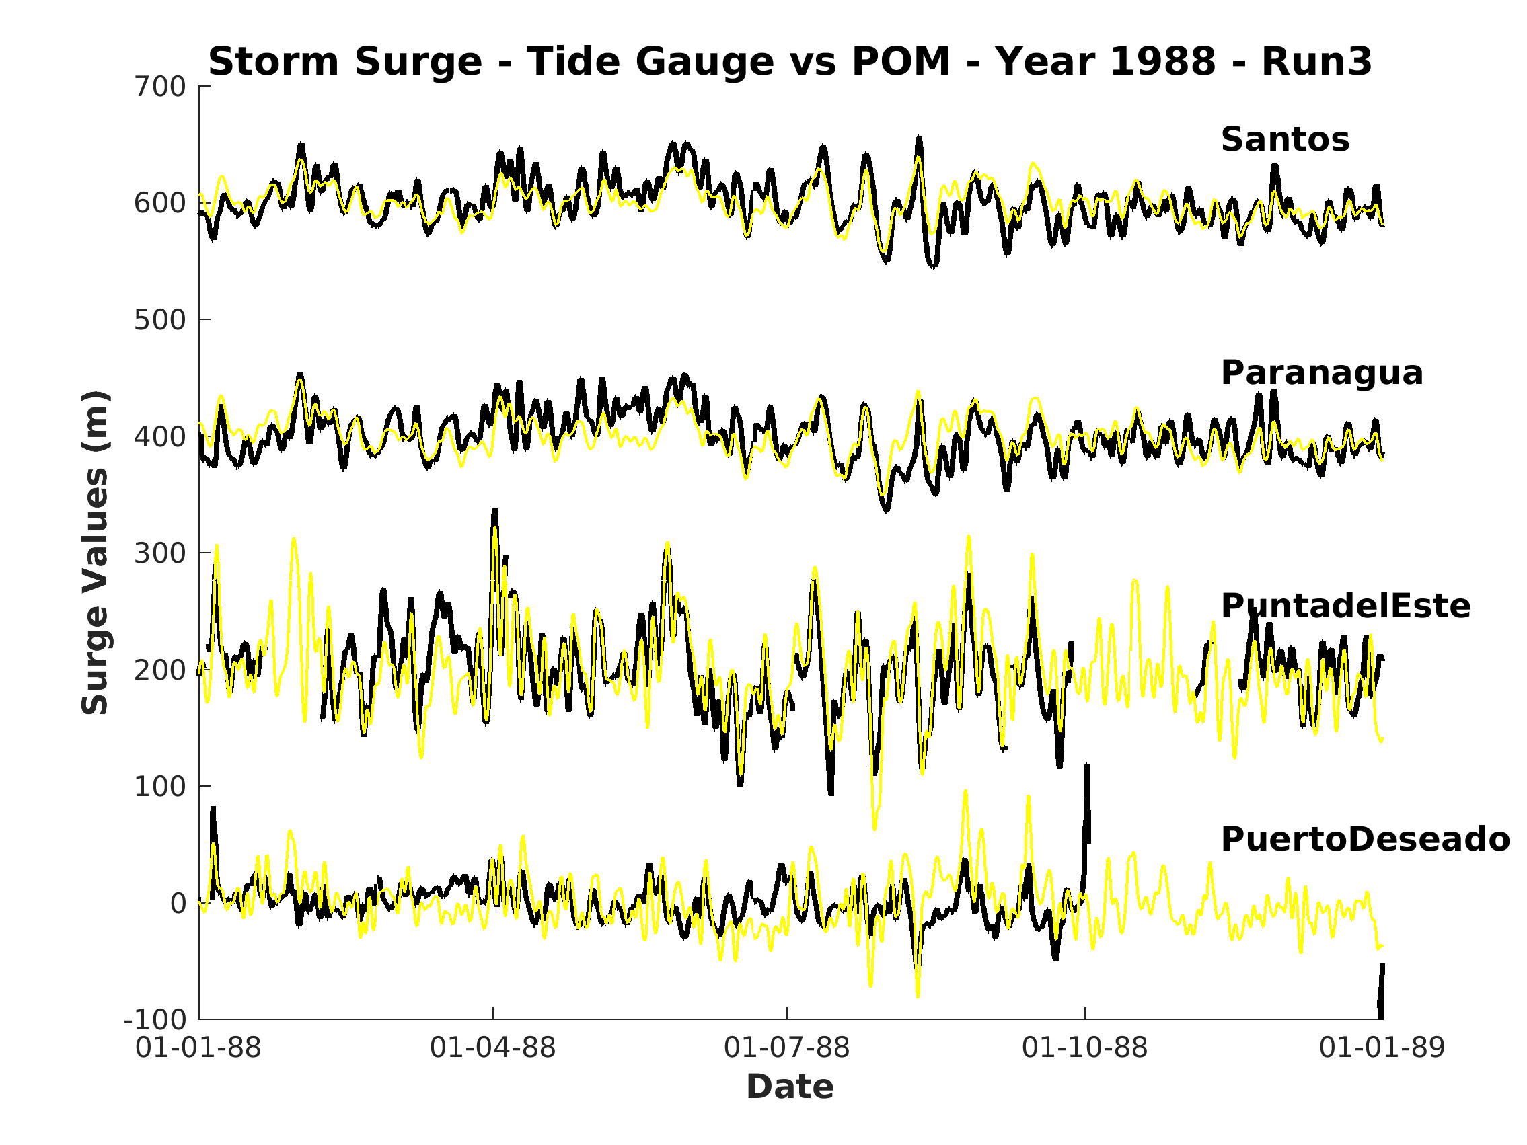
FACTOR SEPARATION

Slide 35
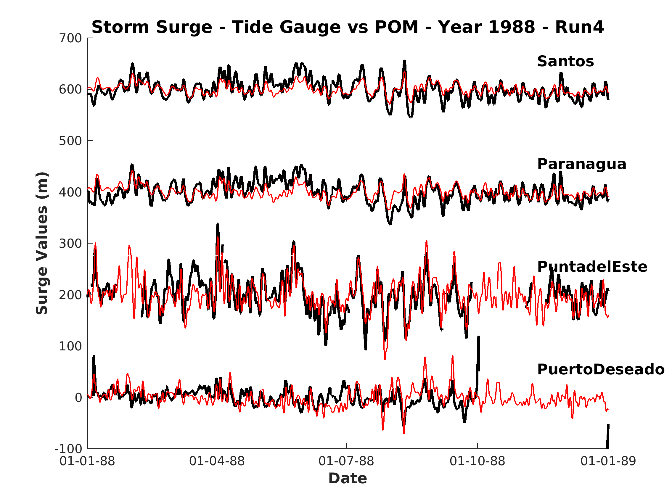
FACTOR SEPARATION

Slide 36
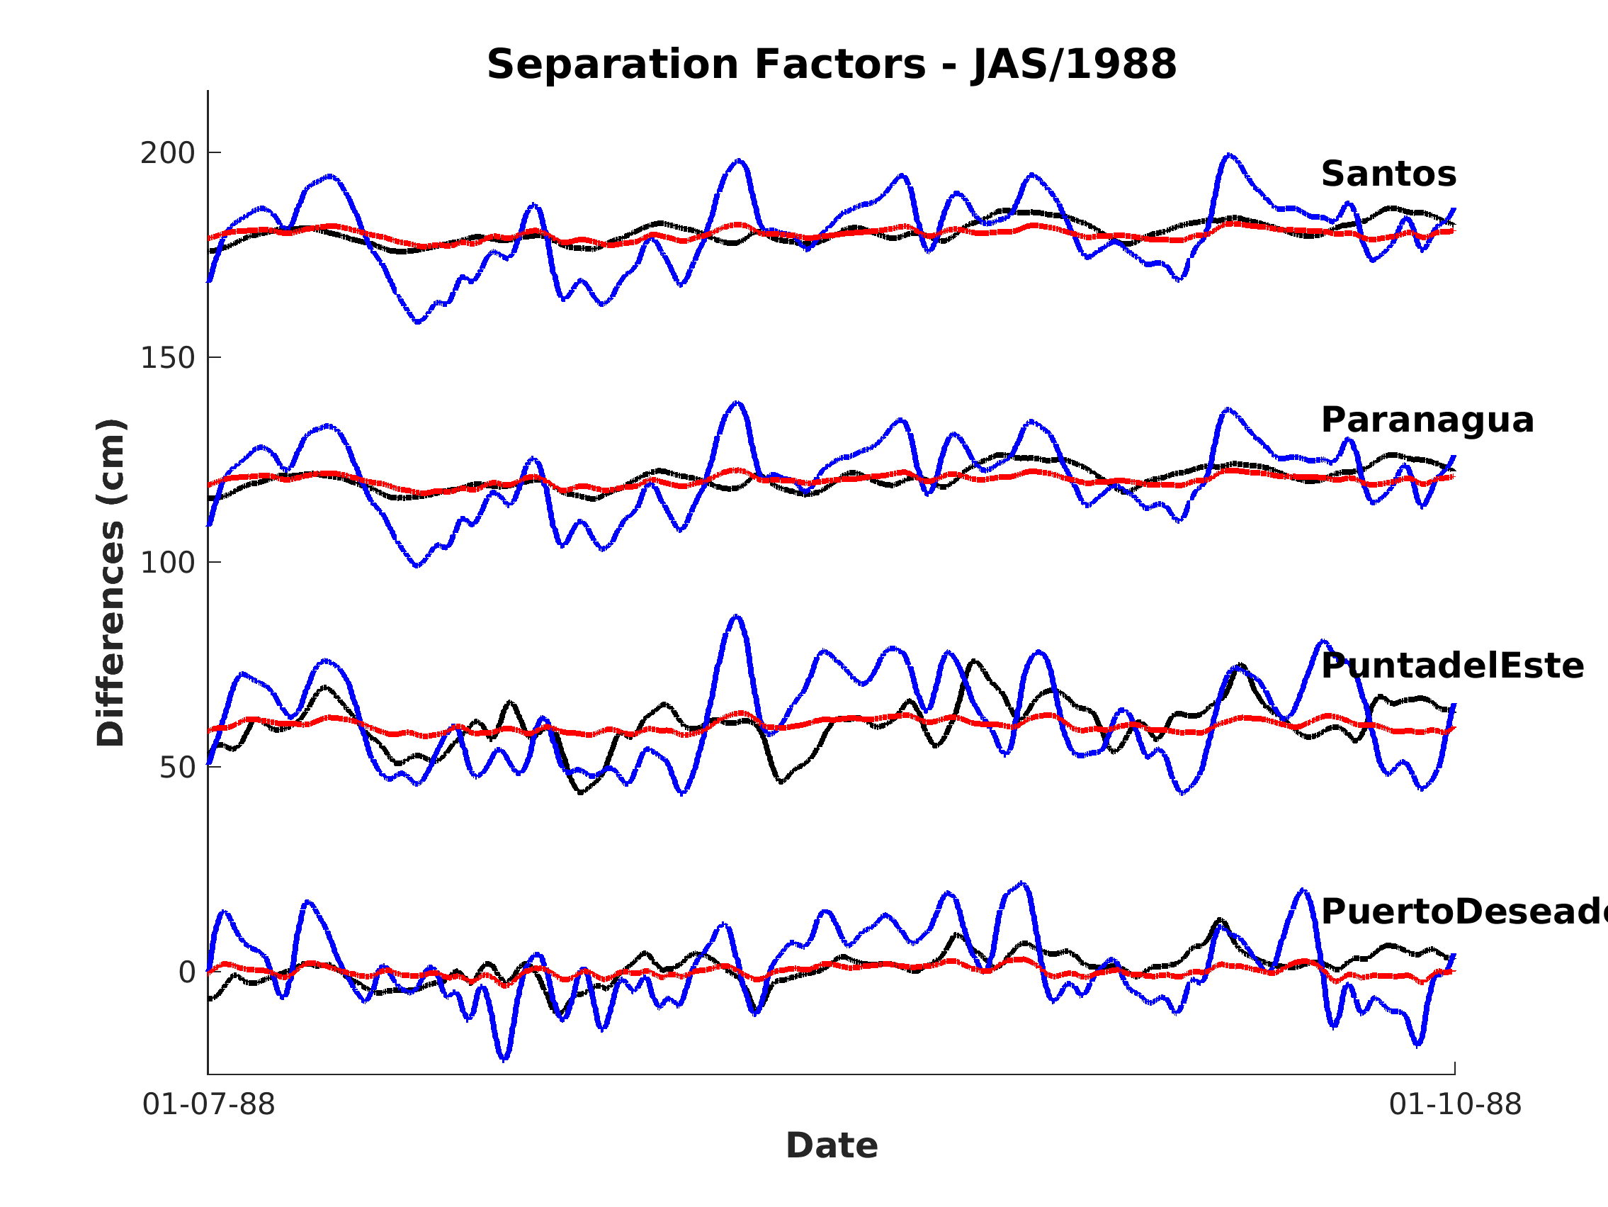
FACTOR SEPARATION
50 cm
Tide effect SLP effect Non linear effect Tide/SLP

Slide 37
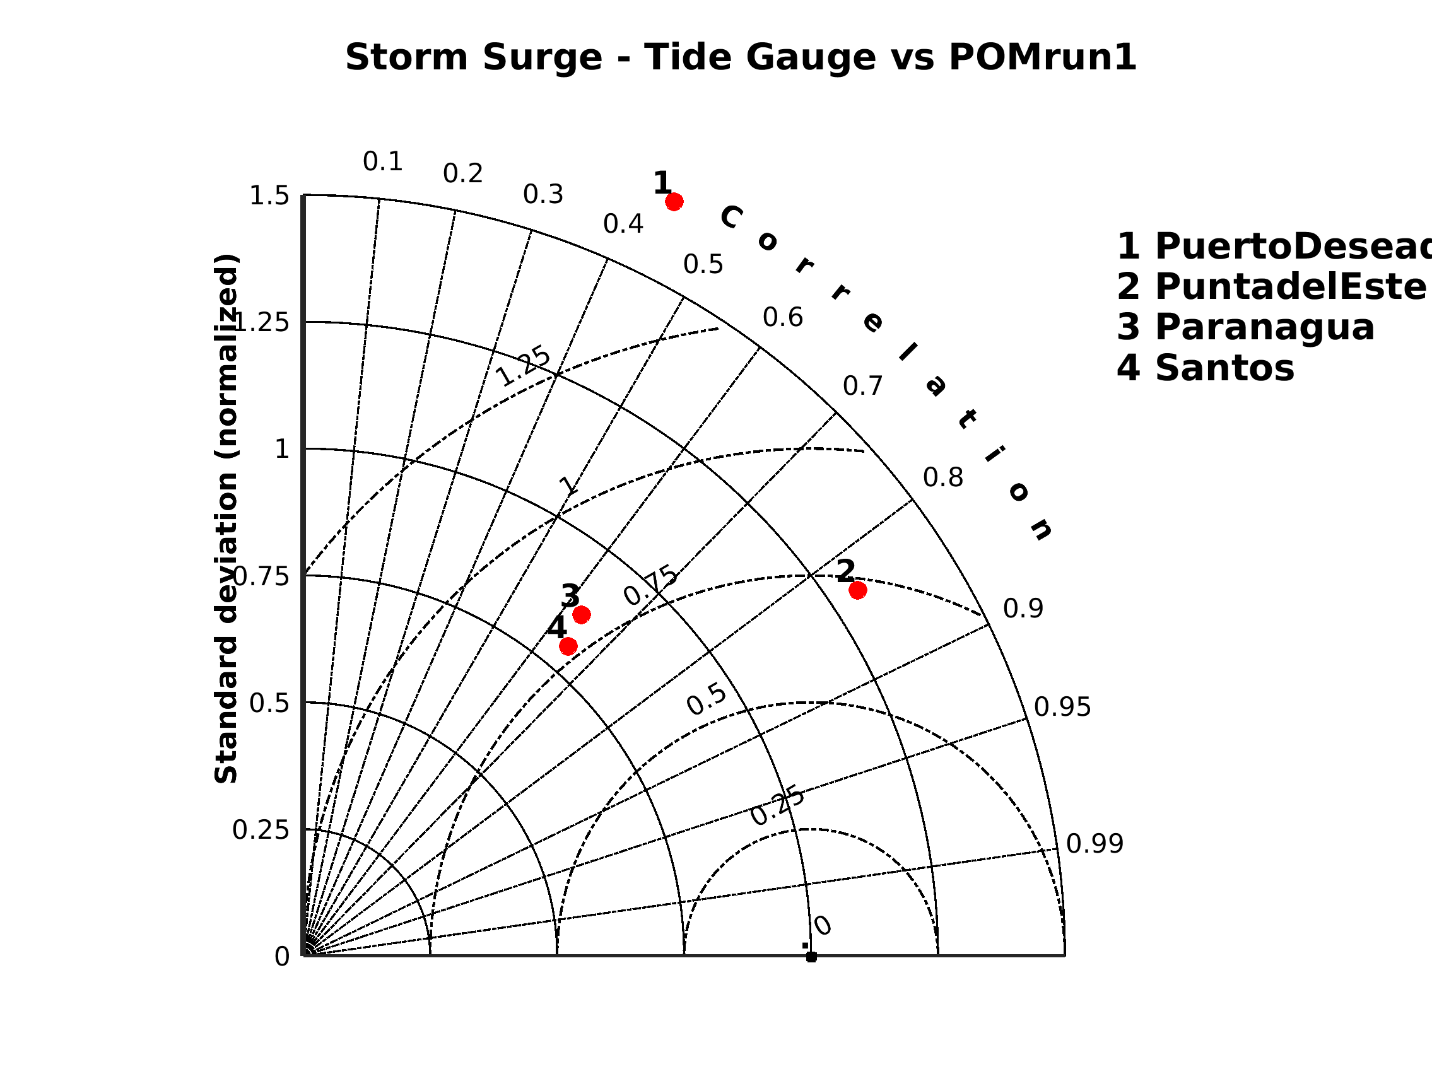
Only 1988

Slide 38
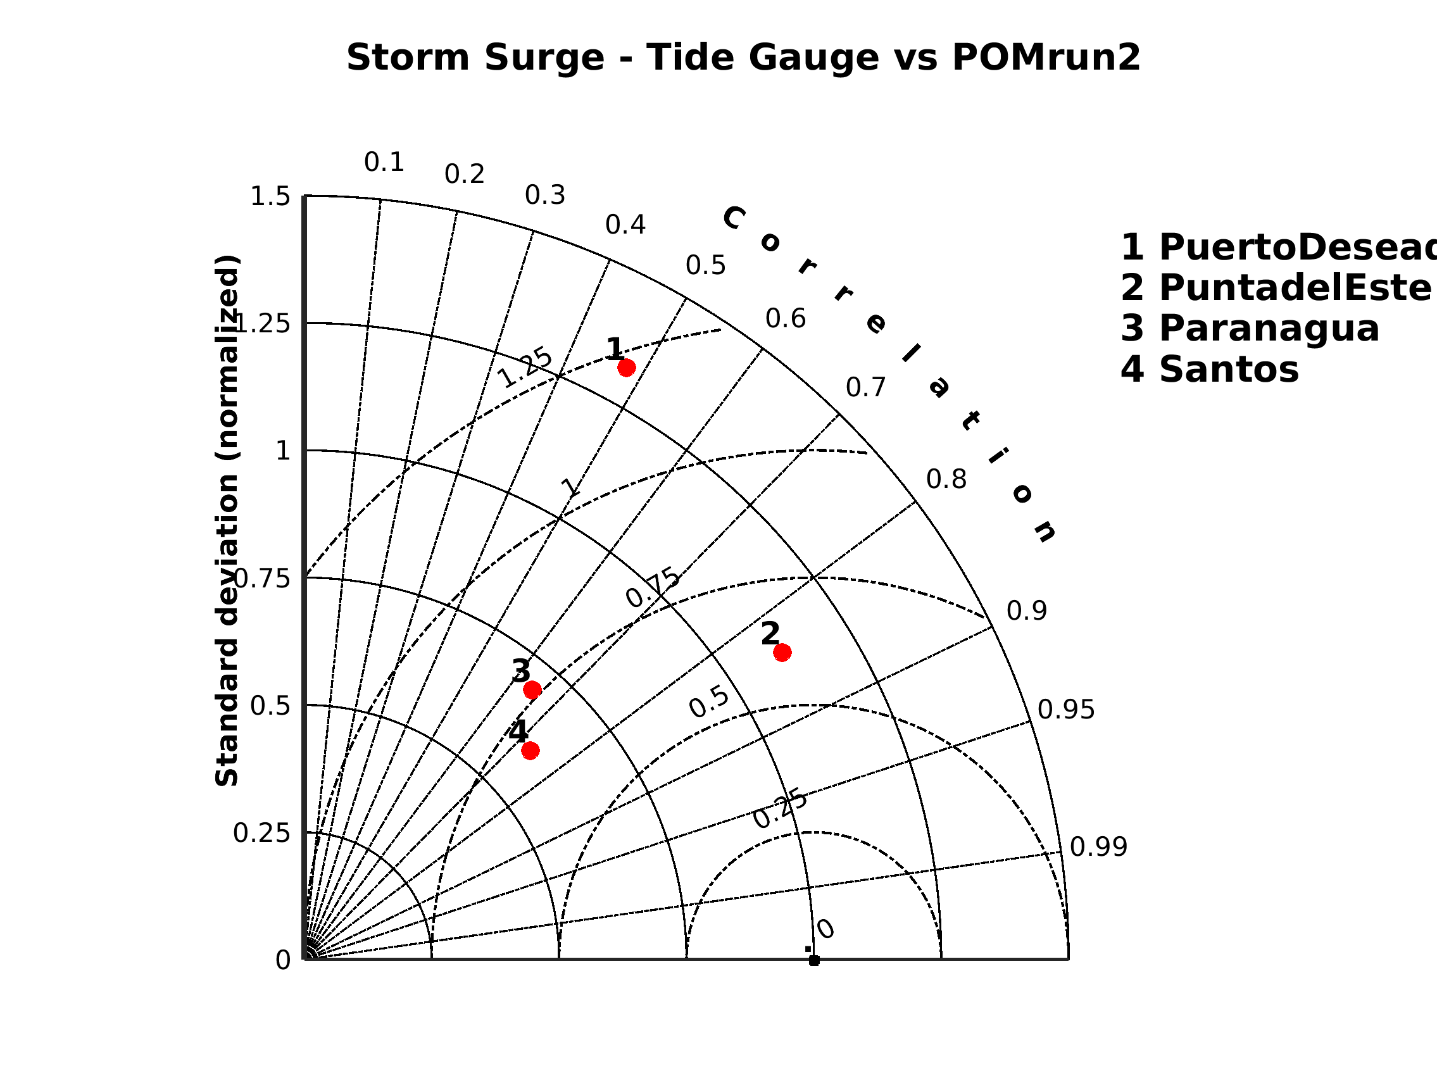
Only 1988

Slide 39
Only 1988

Slide 40
Only 1988

Slide 41
DISCUSSION AND CONCLUSIONS
astronomical constituents were well represented, although amplitude and phase errors occurs mainly in the southern portion of the analyzed domain; major phase differences for diurnal constituents, with 1 hour error and almost 50% in amplitudes
subtidal sea level oscillations were, in general, overestimated in central and northern Argentina and underestimated in Southeastern Brazil
from observations, one can observe more amplified events from Puerto Madryn to North, meaning that the main region for storm surge generation in the Western South Atlantic is located north of 45ºS

Slide 42
DISCUSSION AND CONCLUSIONS
considering the simultaneous series of sea level at the coast and shlef wind:
high frequency and higher values occur at southernmost locations (from north down to 45ºS)
some events are generated north of 40ºS and their influence is over the northern part of the study region, but their amplitudes normally are not the biggest
some events affect the whole region, negative or positive

Slide 43
DISCUSSION AND CONCLUSIONS
combined EOF analysis shows the first two modes representing 50% of the joint variability of subtidal sea level and wind; including 3rd and 4th modes, more than 75% of the variability is described
the first two modes can be directly associated to the midltitude atmospheric systems, expressed by cyclonic and anticyclonic curvatures; within this context, 3rd and 4th modes can be distortions of the transients
time coefficients of 1st and 2nd modes show coherent alternation of polarity
tides and SLP are important and their combination improves the skill for extreme cases
SLP: not directly the inverted barometer effect, but its residual effect

